Slide 1
Get started with
Microsoft 365 Copilot App
Practical examples and how-tos for licensed Microsoft 365 Copilot users
Note: “Product user interface shown is current as of May 18, 2026 and is subject to change. Features, functionality, and visual elements may vary over time"
May 2026

Slide 2


Here’s what you’ll learn in this deck
How to use the capabilities of the Microsoft 365
Copilot app
Suggested use cases and hero prompts for each capability

Slide 3
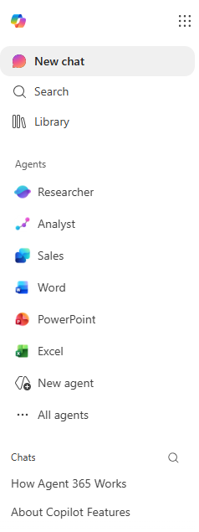
What is the Microsoft 365 Copilot app?
Apps
Get started with the Microsoft 365 Copilot App
The Microsoft 365 Copilot app is designed for the new way of working. It is your starting place for AI at work, where you can chat with Copilot, find work files, collect and organize notes, create content, and complete tasks all in one place.
The Microsoft 365 Copilot app includes different modules to tackle aspects of your day-to-day work, including:
Chat: AI chat that connects to work and/or web data
Search: Find information across your work context
  Library: Location to find your Pages and Images
  Agents: Automate repetitive tasks and processes
  Chats: Access your conversation history
Apps: Access additional apps
  Create: Create high-quality images, graphics, and videos with AI
  Notebooks: Organize your notes, documents, websites, and meeting recordings
  Office 365: Open online versions of your Office 365 apps
Note: “UI shown as of May 18, 2026. Product features and visuals may change.”

Slide 4
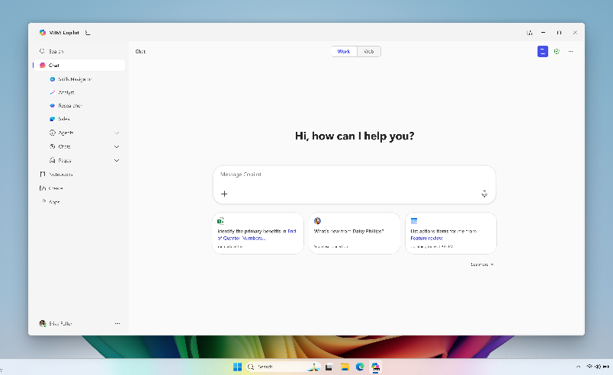
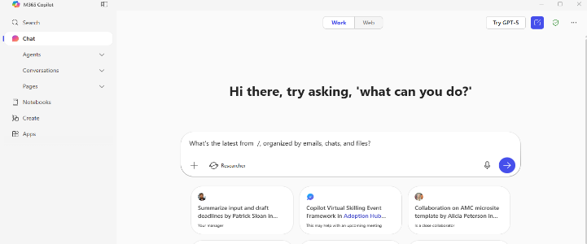


How to access the app
Windows taskbar – Your admin can pin the app to your Windows task bar so it should be there automatically. If not, you can pin it there yourself.
Web link – Using the link – M365Copilot.com will open the app in your browser.
    If you need to download the app
    For Windows devices download here
      Pin to taskbar: With the app open, right-click the taskbar icon and select Pin to taskbar.
    For Mac devices download here
    For iOS and Android, download Microsoft 365 Copilot in the app store
Note: “UI shown as of May 18, 2026. Product features and visuals may change.”
Notes:
You can access the Copilot app in two ways:
Windows Taskbar: Your admin can pin the app for you, or you can pin it yourself.
Web Link: Visit M365Copilot.com to open the app in your browser.
You can also show this video if you want to demo how to get into the app - https://support.microsoft.com/en-us/topic/video-tutorial-try-out-copilot-chat-on-desktop-mobile-edge-or-microsoft365-com-39de776c-2de9-4b40-8c17-ed7b3d30c3d6
Recommended activity – if your admin has not pinned Copilot to the taskbar then have people pin it themselves
Steps to Pin Copilot to Taskbar
Open the Start Menu: Click on the Windows icon on your taskbar or press the Windows key on your keyboard.
Search for Copilot: Type “Copilot” in the search box to locate the Copilot application.
Pin to Taskbar: When the Copilot app appears in the search results, right-click on it to reveal a context menu. Select “Pin to taskbar” from the menu. This will add the Copilot icon to your taskbar for easy access.
Verify the Pin: Check that the Copilot icon now appears on your taskbar, allowing you to launch it with a single click.

Slide 5

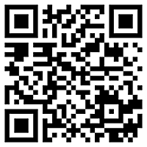
Use Microsoft 365 Copilot on the go
Download the Microsoft 365 Copilot mobile app and sign in with your work or school account to access Copilot Chat
Download Microsoft 365 Copilot App | Microsoft 365
Notes:
Download the Microsoft 365 Copilot mobile app and sign in with your work or school account to access Copilot Chat anywhere. Use the QR code or the provided link to get started.
Recommended activity:
Have everyone use the QR code to install the app on their phone

Slide 6
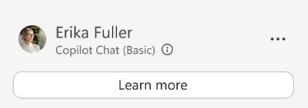
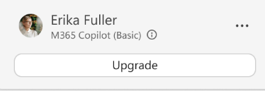

Understand your Microsoft 365 Copilot app experience
Users can identify which experience they have based on in-product labels. If you see “M365 Copilot (Premium)”, you have a Microsoft 365 Copilot license have full access to Copilot and agents using Work IQ. Users who see either the “Copilot Chat (Basic)” or “M365 Copilot (Basic)” labels in-product have access to Copilot with web data.
 | Look for the indicator under your profile icon and name | What you can do
“Copilot Chat (Basic)” | “Screenshot of Copilot Chat showing a user profile labeled ‘Erika Fuller’ with the status ‘Copilot Chat (Basic)’ and a ‘Learn more’ button below.” | Results based on web data and files you manually add to your prompts Standard access to the latest OpenAI models, Create, and dictation Access to agents that use web data otherwise agent usage is pay as you go
“M365 Copilot (Basic)” | “Screenshot of M365 Copilot interface showing a user profile labeled ‘Erika Fuller’ with the status ‘M365 Copilot (Basic)’ and an ‘Upgrade’ button below.” | Results based on web data and files you manually add to your prompts Standard access to latest models, Create, and dictation Access to agents that use web data otherwise agent usage is pay as you go
“M365 Copilot (Premium)” | “Screenshot of M365 Copilot interface showing a user profile labeled ‘Erika Fuller’ with the status ‘M365 Copilot (Premium)’.” | Choose to use web data or Work IQ in results Priority access to the latest models, Create, and dictation Access to Claude models, Notebooks, Researcher, Analyst, Sales, Service, Finance and other agents. Full access to agents

Slide 7

























What is Work IQ? (Premium Only)
Work IQ, which can be accessed with a Copilot license, helps Copilot understand you and your organization, so you get personalized AI assistance.
It connects Copilot to your emails, meetings, files, and business data, so you get results that incorporate what’s happening in your work right now—not generic responses. With Work IQ, Copilot also knows context like your preferences and collaborators, without you having to explicitly explain in your prompt.
With Work IQ, Copilot can:
Identify your priorities and urgent action items to surface relevant information.
Remember your preferences, like the format or tone you like to receive updates.
Provide insights about a project or topic from across your related work communications and documents.
Prepare you for meetings with relevant context and talking points.
Draft content that reflects your work and priorities.
Work IQ

Slide 8
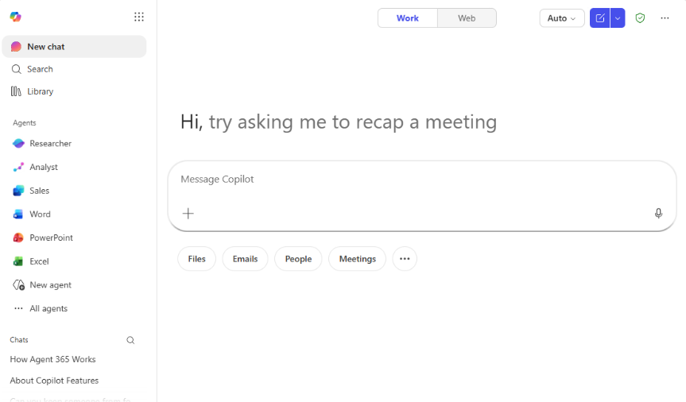
Chat
Get started with Chat in the Microsoft 365 Copilot App
Chat is at the center of Microsoft 365 Copilot, offering secure, AI chat designed for work. Ask questions, get insights, or create new content—all using your work sources and the latest information from the web. Using Copilot Chat is also secure, with enterprise data protection applying to your chats.
With Chat, you can:
Explore new ideas and problem solve across web and work data by asking questions using conversational language. When licensed, Copilot will use advanced reasoning models for more complex queries.
Generate content like summaries, emails, images, and data visualizations.
Convert AI outputs into durable content in Copilot Pages, designed for dynamic collaboration with AI and your teammates.
Notes:
Let’s chat about Copilot Chat—literally!
Copilot Chat is kind of the heart of the Microsoft 365 Copilot app. Think of it as your secure, AI-powered work buddy that’s always ready to help. You can ask questions, get insights, or even create new content—like summaries, emails, images, or data visualizations—just by typing what you need.
What’s really cool is that Copilot Chat pulls from your work sources, so it’s not just guessing or making things up. It uses your files, emails, chats, and even the latest info from the web (if you want), and it’s all protected by enterprise security—so you don’t have to worry about your data.
You can use Copilot Chat to brainstorm ideas, solve problems, or just get quick answers. And if you want to turn your chat into something more permanent, you can convert it into a document or a page for collaboration. It’s super flexible!

Slide 9


How to chat in 3 steps
1. Enter your prompt
2. Check sources
3. Continue the conversation
Enter your detailed prompt in the prompt box. If you would like to reference a work file, email, or meeting, use the slash “/” key and start typing the name of the reference to find it. Use the “@” key to call an agent and start chatting with it.
Chat is transparent about the sources of its information. See these sources listed underneath the response.
Vet these sources and validate your answers.
You can ask follow-up questions as you would in a conversation. You can refine the answer too.
For example, try “Write a shorter answer” or “Give me more detail about [topic].” You can also select suggested prompts.
Notes:
Let’s break down how easy it is to use Copilot Chat—just three simple steps!
Step one: Just type your question or prompt into the chat box. With Chat the more information you can provide the better. Tell Copilot what role it should have, what tone to use, how detailed you want it to be, etc. If you want to reference a file, email, or meeting, you can use the slash “/” key and start typing the name, or use “@” to call an agent. Super straightforward!
Step two: Once Copilot gives you an answer, check out the sources listed underneath the response. Copilot is transparent about where it’s pulling info from, so you can see which files, emails, or chats it used. It’s a great way to double-check and make sure you’re getting accurate info.
Step three: Keep the conversation going! You can ask follow-up questions, ask Copilot to make the answer shorter or more detailed, or just keep refining until you get exactly what you need. It’s just like chatting with a helpful coworker—Copilot is always ready for another round.

Slide 10



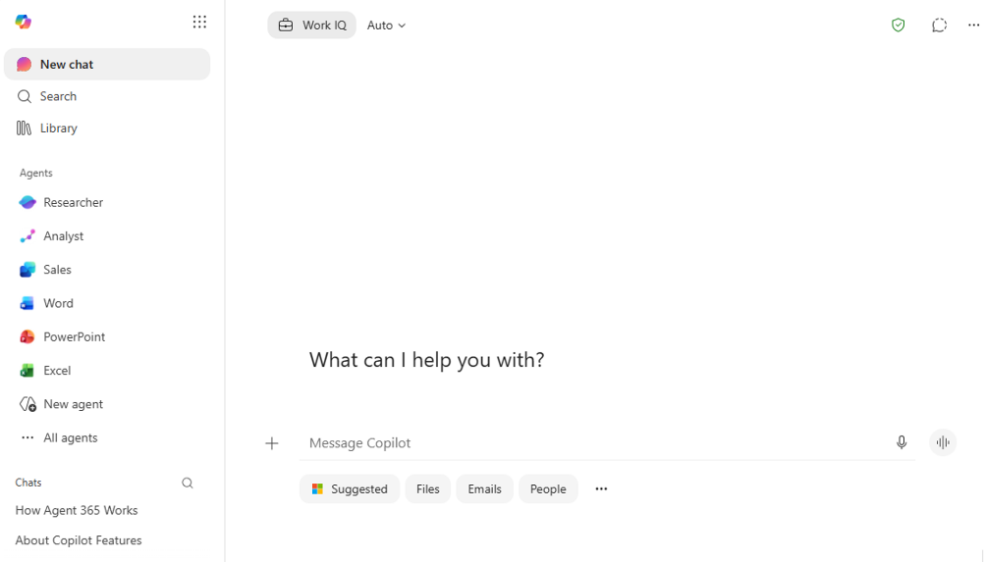

Get to know Chat
Work IQ toggle
Choose to disable/
enable Work IQ.
Auto – model selection Button to Quick response, Think deeper and make manual model selections.
Enterprise data protection
shield – indicates your data is protected.
New Chat
Select the Chat module.
Start a temporary chat – Chat without saving the content.
Prompt Box
Start your chat here.
More options – feedback and controls options.
Add content
Add files and images to the prompt and select agents to include in the prompt.
Start dictation
Record a prompt
Start a voice chat
Have a conversation with Copilot
Chats
View your chat history and select chats to continue them.
Get started with voice features in Microsoft 365 Copilot
Prompt Gallery
Get started with prompt suggestions personalized to you. Clicking on the “…” will open the Prompt Gallery window.
Note: “UI shown as of May 18, 2026. Product features and visuals may change.”
Notes:
Let’s get to know Copilot Chat a little better!
When you open Copilot Chat, you’ll see it’s packed with features designed to make your work life easier. First off, you can choose between “Work” and “Web” modes, so Copilot knows whether to pull info from your company data or the internet. You only see the Work/Web selection when you have a M365 Copilot license.
There’s a button to try out GPT-5, which is the latest LLM from OpenAI. You can use this for all of your chats. You do have to select it every time you start a new chat. You should generally receive higher quality answers. The only think to keep in mind is that with GPT-5 Copilot may decide to use the deep reasoning model to give you a thorough answer, which can take a minute or two.
You’ll also see suggested prompts and a link to prompt gallery, which is awesome if you’re not sure what to ask or just want some inspiration.
Copilot keeps your chat history organized, so you can revisit past conversations or pick up where you left off. And you can access all of your Pages to continue working on response content.

Slide 11

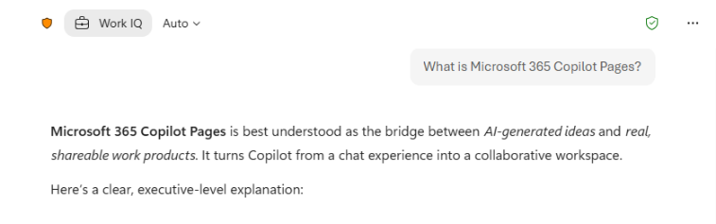

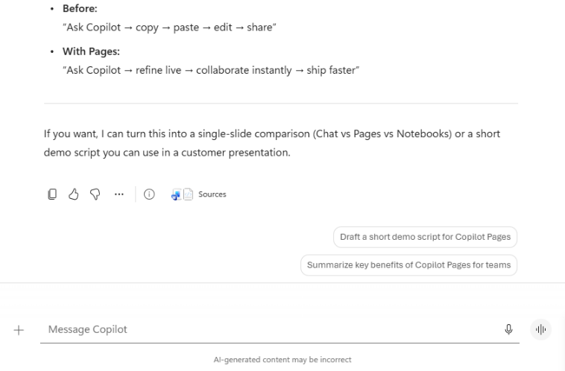
Chat response
Response options
Actions you can take with the prompt
Copy response
Copy the response to
the clipboard to paste in
another location
Prompt
Hover over the prompt to see actions you can take
I like something
Provide positive feedback to your admin and Microsoft
Edit the prompt
Will copy the prompt into the prompt box for editing
I don’t like something
Provide positive feedback to your admin and Microsoft
Copy
Copy the prompt to the clipboard to insert in another app
••• - Split to fit on the slide – full response not shown
More options
Save
Save the prompt to the prompt gallery
Share prompt and copy with response
Create a link for the prompt in Copilot Chat. Copies the prompt and response with the link to provide context
Copy prompt link
Create a link to the prompt you can share with others
Edit in pages
Options to copy to a new Page or copy into an existing Page
Prompt response
See the response here. Click on Sources to find references to files or web sites used
Schedule this prompt
Schedule a prompt for a later time
Multi-turn suggestions
Continue the conversation with these suggestions to enhance your response.
Read aloud
Copilot will read the response
to you
Open in Word
Copy the response into a Word document for editing
Prompt Box
Continue your chat here
Sources
Opens a sidebar with links to all sources
Note: “UI shown as of May 18, 2026. Product features and visuals may change.”
Notes:
Let’s talk about what happens after you send a prompt in Copilot Chat.
When you ask Copilot a question, it doesn’t just give you a quick answer and move on. Instead, you get a detailed response and Copilot shows you where it got its information—so you can see the sources, like files or websites, that it used to build the answer. This is super helpful if you want to double-check something or dig deeper.
You’ll also notice there are lots of options for what to do with Copilot’s response. You can copy it to your clipboard, share it with a colleague, or even save the prompt if you think you’ll want to use it again later. If you want to keep working on the answer, you can edit it right in Copilot Pages, or open it in Word for more formatting.
Another cool thing: Copilot gives you suggestions for follow-up questions, so you can keep the conversation going and get even more out of your chat. And if you like or don’t like a response, you can give feedback to help improve Copilot for everyone.

Slide 12
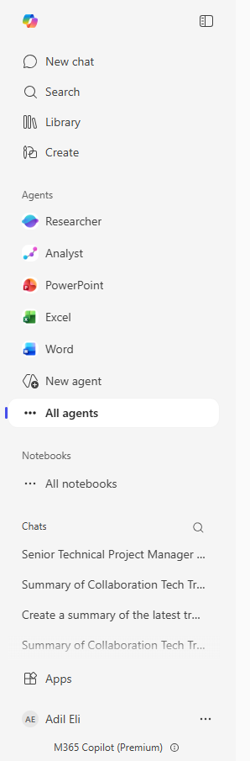
Chat conversation history
Revisit your Microsoft 365 Copilot Chat history
You’ll find your chat history in the Microsoft 365 Copilot app. Look for Conversations under the Chat module.
You can continue any conversation with Copilot simply by selecting it from the list.
Copilot automatically generates a title for each chat that reflects what the chat seemed to be about. To rename or delete a conversation select the More button next to the conversation name and select either Rename or Delete.
Note: “UI shown as of May 18, 2026. Product features and visuals may change.”
Notes:
Let’s talk about keeping track of your Copilot Chat conversations.
One of the really handy features in the Copilot app is that it automatically saves your chat history. So, if you’ve ever had a great conversation with Copilot—maybe it helped you draft an email, summarize a meeting, or brainstorm ideas—you don’t have to worry about losing it.
You’ll find all your past chats under the “Conversations” section in the Chat module.
You can scroll through your list of conversations, pick up where you left off, or revisit something you worked on earlier. If you want to keep things organized, you can even rename your chats to something more memorable or delete the ones you don’t need anymore. Just click the “More” ellipses next to the conversation name for those options.

Slide 13
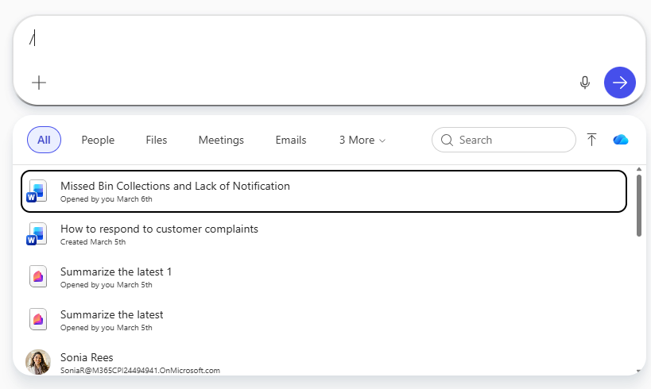
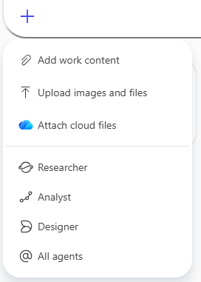
Include a work source in your prompt
Using Context IQ to refer to specific files, people, and more in Microsoft 365 Copilot and Copilot Chat
Want Copilot to respond using information from a Word document, PowerPoint deck, or other file? Select the “+” icon in the prompt box or enter a “/” as part of your prompt. These both allow the same actions
Select from a list of recent files
Upload a local file from your machine
Select a cloud file from SharePoint ore OneDrive
Recent files box
Select from recent files. This selection box will appear if you select:
+ then Add work content
/ in the prompt box
Upload images and files
Select from local files on your computer.
You can access this by selecting:
+ then Upload images and files
/ in the prompt box then the upload icon from the recent files box
Add content selection box
Attach cloud files
Select from SharePoint or OneDrive files.
You can access this by selecting:
+ then Attach cloud files
/ in the prompt box then the cloud icon from the recent files box
Note: “UI shown as of May 18, 2026. Product features and visuals may change.”
Notes:
Let’s talk about how you can make Copilot’s answers even smarter by including work sources in your prompt.
If you want Copilot to use information from a specific file, email, meeting, or chat, you’ve got two easy options:
First, you can click the “+” button in the prompt box. This lets you add work content, upload a file from your computer, or attach something from SharePoint or OneDrive.
Second, you can just type a slash “/” in the prompt box while you’re writing. This opens up a menu where you can search for and include files, emails, meetings, or chats directly.
Both methods let you quickly pull in recent files or upload something new, so Copilot knows exactly what to reference when answering your question.
Bottom line: Adding work sources to your prompt gives Copilot more context, which means you get more accurate, relevant answers—without having to dig for the info yourself.

Slide 14
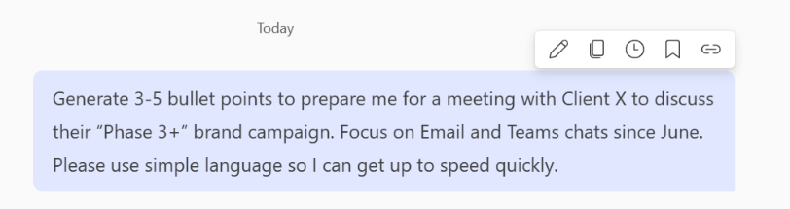
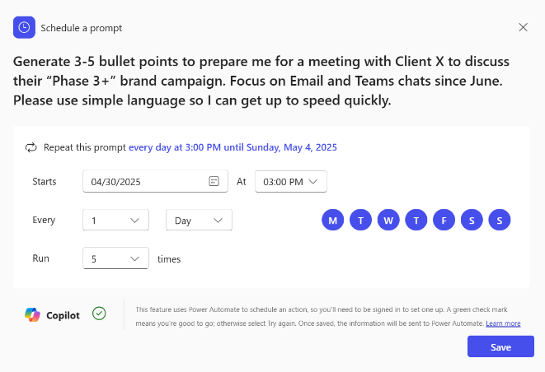
Save, schedule, and share your favorite prompts
Find a prompt that is really helpful? Save it so you can easily send it again next time. Just hover over the prompt after you’ve sent it and select the bookmark icon. You can find your saved prompts in the Copilot Prompt Gallery.
You can also schedule the prompt to run automatically at a certain time or cadence by selecting the clock icon.
Think others would benefit from the prompt too? Select the link icon to copy a link to the prompt and share it with colleagues so they can try out the prompt too.
Note: “UI shown as of May 18, 2026. Product features and visuals may change.”
Notes:
Now, let’s look at how you can make your favorite prompts work even harder for you!
If you find a prompt that’s really helpful, you can save it by hovering over the prompt after you’ve sent it and clicking the bookmark icon. All your saved prompts are easy to find in the Copilot Prompt Gallery, so you don’t have to reinvent the wheel every time.
You can also schedule prompts to run automatically at a certain time or on a regular cadence—just click the clock icon. This is great for things like daily summaries or weekly reports.
And if you think a prompt would help your teammates, you can share it by clicking the link icon. This copies a link to the prompt so your colleagues can try it out too.
So, whether you want to save time, automate routine tasks, or help your team, these features make Copilot even more powerful and collaborative.

Slide 15
Try it out
Use Case | Prompt | Copilot experience
Get up to speed: Create summaries and lists of key points, tasks, and updates in a flash. | Try the prompt: What’s the latest from [person], organized by emails, chats, and files? | Premium
Jumpstart the creative process: Say goodbye to writer’s block and use Copilot to generate content and ideas. | Try the prompt: Write a one-sentence tagline for [product]. Make it catchy and fun, while conveying the product benefits | Premium
Build your expertise: Research new topics or simplify complex documents and articles. | Try the prompt: Summarize information from [company]’s website and annual reports. | Basic and Premium
Find files and information: Quickly find what you’re looking for across your apps and files. | Try the prompt: Try the prompt: When is my next meeting with [person]? | Premium

Slide 16
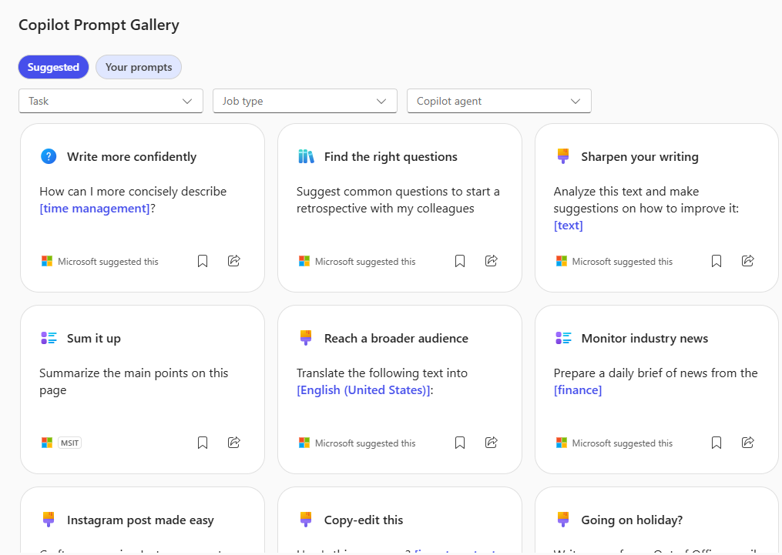
Get prompt inspiration
Copilot Prompt Gallery helps you find prompting inspiration so you can take greater advantage of Copilot in your daily work.
Explore the curated selection of Copilot prompts
View your saved prompts
View prompts from your team
Share your favorite prompts with colleagues
Find prompting inspiration from others
Access the Prompt Gallery in Copilot Chat by
Clicking to See more prompts in Chat
Selecting Prompt Gallery
Watch the video to see it in action
Note: “UI shown as of May 18, 2026. Product features and visuals may change.”
Notes:
Let’s talk about getting inspired with Copilot prompts!
Especially when getting started with Copilot it can be a challenge to figure out what to ask. That’s where the Copilot Prompt Gallery comes in. It’s basically a collection of creative, useful, and sometimes even fun prompts that you can use to get more out of Copilot.
You can browse through a curated selection of prompts—these are ideas that Microsoft and your organization have found helpful. If you find a prompt you really like, you can save it for later, so you don’t have to remember it or type it out again. You can also see prompts that your teammates have shared, which is a great way to learn new tricks or discover ways Copilot can help with tasks you hadn’t even thought of.
If you come up with a prompt that works really well for you, you can share it with others too. Just grab the link and send it to a colleague—they can try it out right away. The gallery is always growing, so it’s a great place to visit when you want to try something new or just need a little inspiration.
Recommended exercise:
Have everyone open the Prompt Gallery and filter for prompts by their role

Slide 17
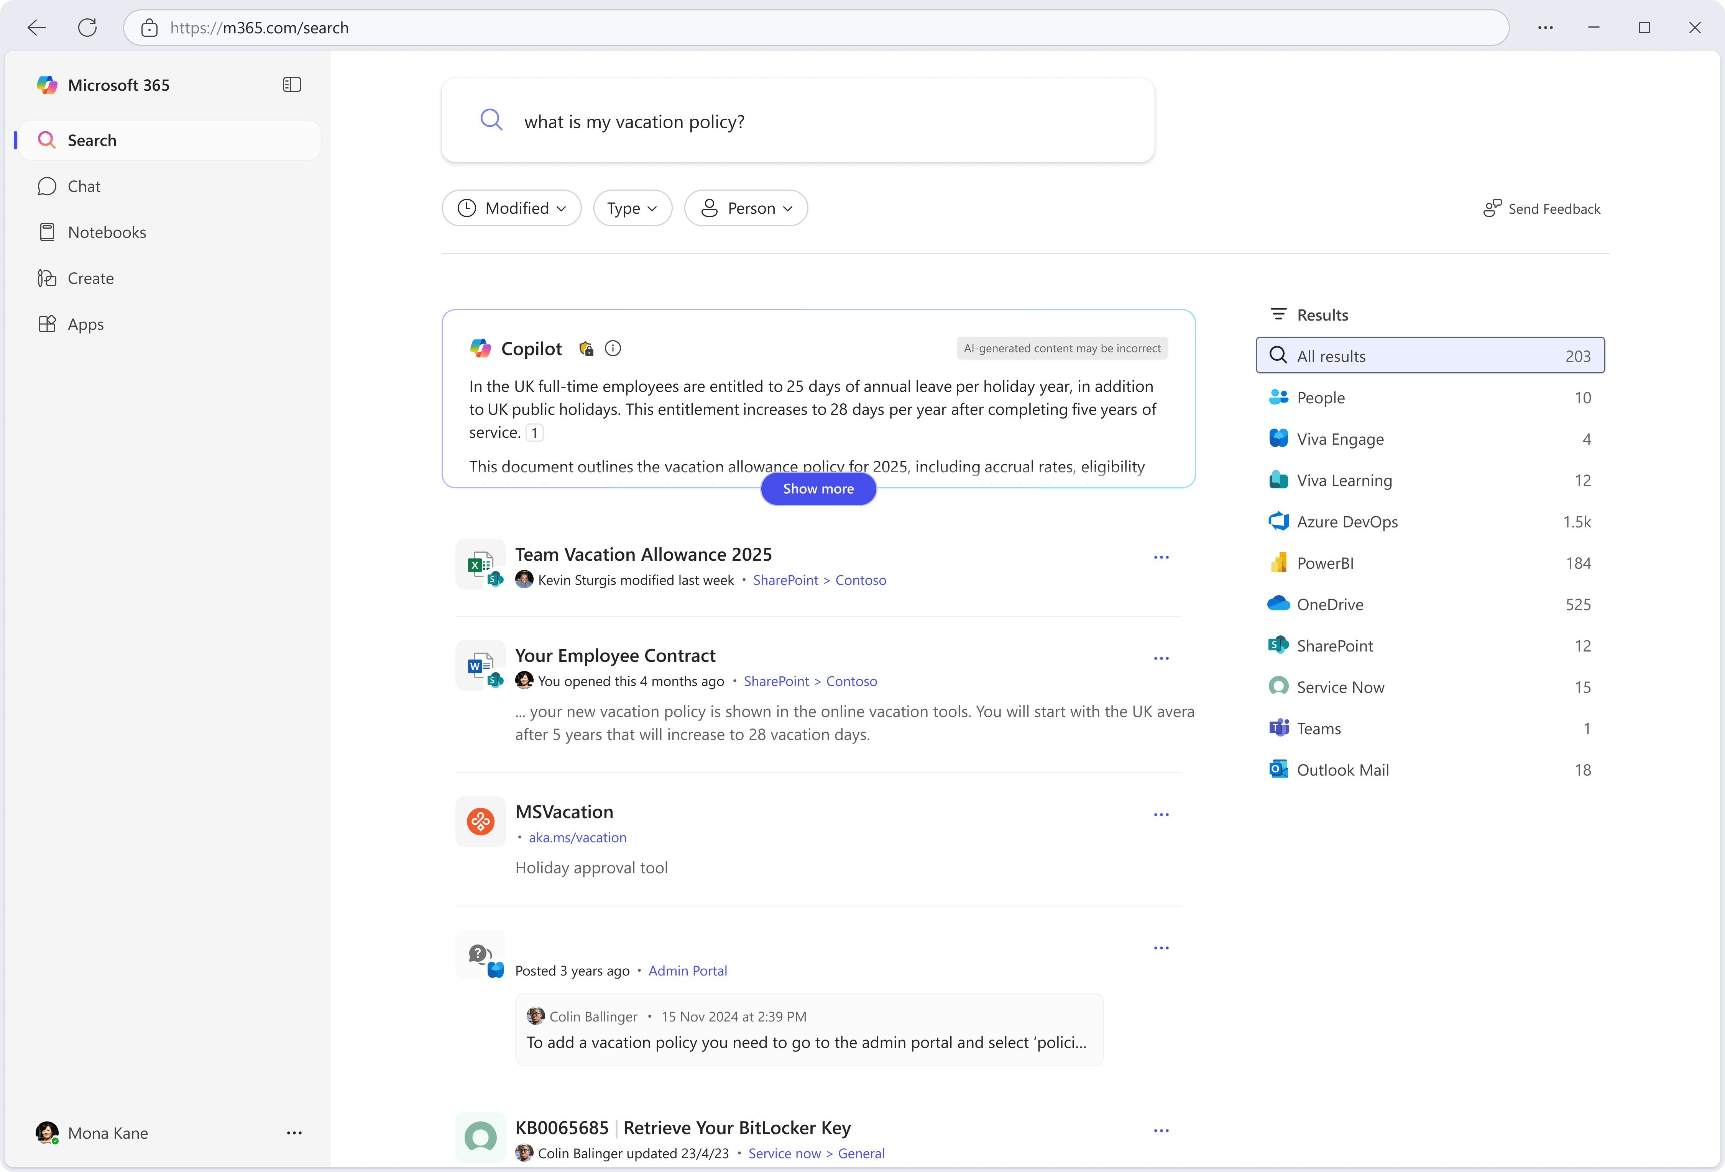
Search
Get started with Search in the Microsoft 365 Copilot App
Search in the Microsoft 365 Copilot app is where you go to find people, chats, meetings, and files. You'll also see recommendations, access recently used files, and review items shared with you.
Search combines natural language understanding with semantic indexing to uncover relevant results.
Search across Microsoft 365, on-premises,
and other LOB applications and services
using Copilot connectors.
Allows admins to curate answers that provide concise, authoritative results that are especially relevant to your organization.
Note: “UI shown as of May 18, 2026. Product features and visuals may change.”
Notes:
Let’s talk about Copilot Search!
So, imagine you’re at work and you need to find something—maybe a file, an email, a chat, or even a meeting note. Normally, you’d have to dig through folders, scroll through your inbox, or try to remember where you saved that document. Copilot Search makes that way easier.
What is Copilot Search?
Copilot Search is like having a super-powered search bar that understands what you’re looking for—even if you’re not exactly sure yourself. You just type in a few keywords, a project name, or even ask a question in plain English, and Copilot will search across your entire work context: files, emails, chats, meetings, and more. It’s not just looking for filenames—it’s actually reading the content, understanding what’s relevant, and surfacing the best results for you.
Why is it awesome?
Saves time: No more hunting through different apps or folders. You get everything in one place.
Smarter results: Copilot uses AI to understand what you mean, not just what you type. So if you search for “budget update from last week,” it’ll find the right emails, chats, or files—even if you don’t remember the exact name.
Organization-wide answers: Admins can curate answers, so you get authoritative, up-to-date info that’s tailored for your company. If there’s a policy or a process you need, Copilot Search can point you to the official source.
Filters and recommendations: You can filter by person, file type, date, or even see recommended content like meeting recaps or files shared with you. It’s super handy when you’re prepping for a meeting or catching up on a project.
Real-life example:
Let’s say you’re about to meet with a client and want to get up to speed. You can search for the client’s name, and Copilot will pull together emails, chats, files, and even meeting notes related to them. You get a quick summary, and you’re ready to go—no stress, no wasted time.
Bottom line:
Copilot Search is all about making your work life easier. It helps you find what you need, when you need it, and lets you focus on actually getting things done instead of searching for stuff. If you haven’t tried it yet, give it a spin—you’ll wonder how you managed without it!

Slide 18
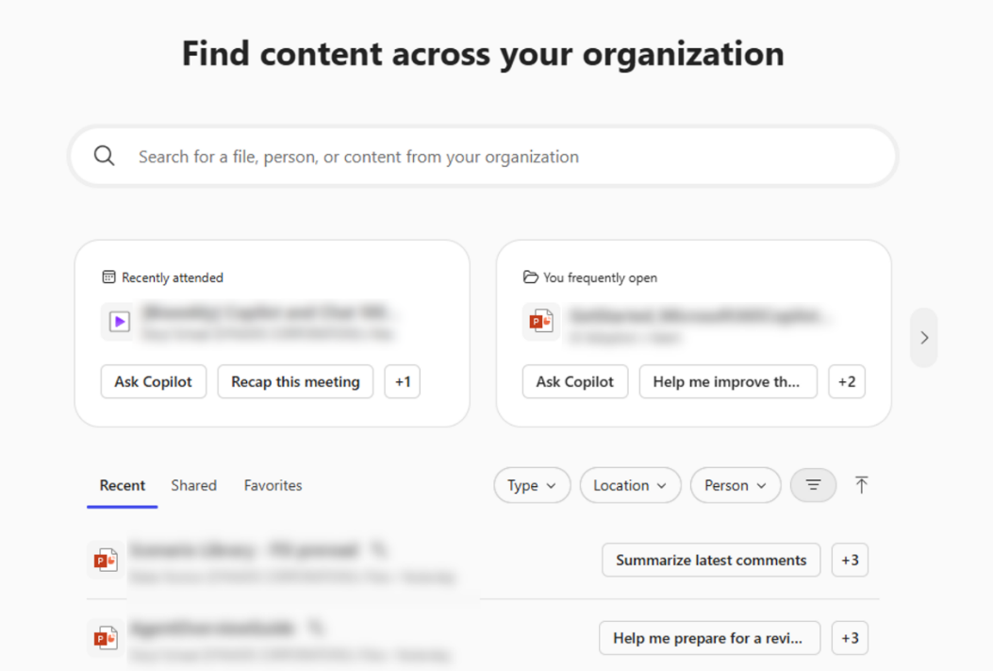
Get started with Search
Prompt Box
Enter your search here
Filters
Use filters to narrow down search results in your Quick Access sections
Recent – Files you recently worked on or accessed
Shared – Files that other users in your organization have shared with you
Favorites – Files that you have marked as a favorite
Type – Based on application
Location – Cloud files or email attachments
Person – Select a person
Recommended content
The Recommended section contains meeting recaps and files relevant to you, each with suggested prompts to help you locate the information you need
Hover over item to
open an expanded view with a summary
Click on the item
to open it
Click on more options to perform other activities like Open, Share, Add to To Do, create a meeting,
or Download
Recommended
prompts – Switch to chat and get information about the item
Quick Access
Works the same as recommended content with the additional options of marking the item as a favorite or converting it to a PDF
Note: “UI shown as of May 18, 2026. Product features and visuals may change.”
Notes:
Let’s talk about how to actually use Copilot Search in your day-to-day work.
So, when you open up Copilot Search, you’ll see it’s designed to help you find stuff fast—whether that’s meeting recaps, files you’ve worked on recently, or things people have shared with you. The cool part is, you don’t have to remember exactly where you saved something or what it was called. You just type in a few keywords, and Copilot does the heavy lifting.
You’ll notice there’s a “Recommended” section right at the top. This is like your personal shortcut—it shows you files and meeting notes that Copilot thinks are relevant to you, and even suggests prompts to help you dig deeper. If you hover over an item, you get a quick summary, so you don’t have to open a bunch of things just to see what’s inside.
There are also filters you can use—by person, file type, location, or even recent activity. So if you’re looking for a spreadsheet someone shared last week, you can narrow it down in seconds.
And here’s a tip: you can mark favorites or even convert files to PDF right from the search results. It’s all about making your workflow smoother and saving you time.

Slide 19
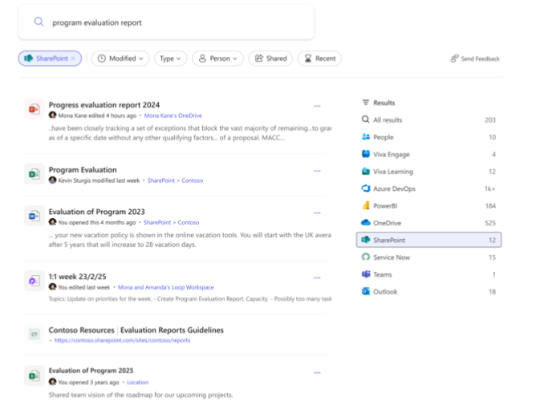
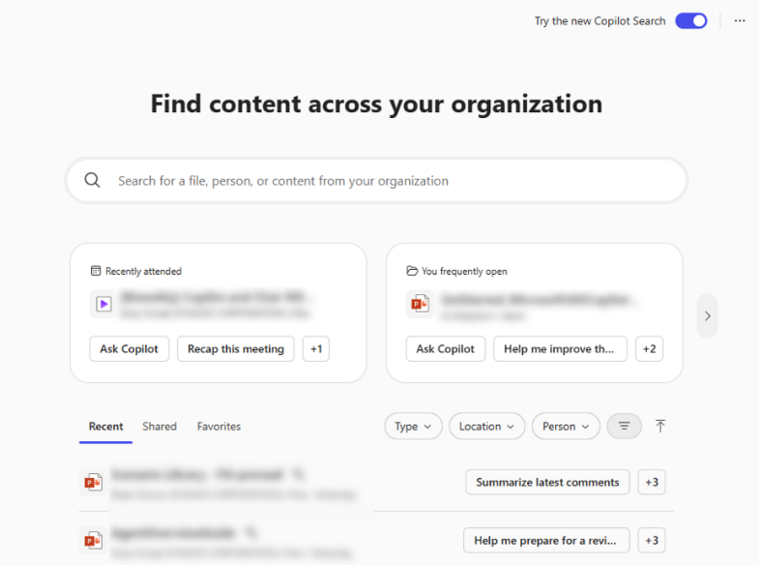
Search results
Prompt Box
Modify your search here
Filters vary by results
Modified – Filter by when the file was last modified
Type – Based on application
Person – Filter by person
Results
Content that you may be looking for. Results include
the content owner, security label, location, and a
short description.
Copilot – Copilot may produce a brief on
the search
Hover over item – Expose the Overview button to see a summary
Clink to open item
More options – Will vary by content type, but generally open, share, or download the item
Filter results by location
Note: “UI shown as of May 18, 2026. Product features and visuals may change.”
Notes:
Alright, let’s talk about what happens after you run a search in Copilot.
When you type in your keywords and hit search, Copilot doesn’t just spit out a random list of files. Instead, it gives you a super organized set of results. You’ll see things like who owns the content, where it’s stored, and even a short description so you know what you’re looking at before you open anything.
If you’re not seeing exactly what you want, you can use filters—like by date, file type, or even by person. So, if you only want files from last month or just spreadsheets, you can narrow it down in a couple of clicks.
One of my favorite features is the “Overview” button. Hover over an item and you get a quick summary, which is awesome if you’re in a hurry and don’t want to open a bunch of files just to check what’s inside. Plus, Copilot can actually generate a brief or summary for you, so if you’re prepping for a meeting or need a quick update, you get the highlights without having to dig through everything yourself.

Slide 20
Prompting guidance
Search is about retrieval. Using keywords
or short descriptions to find something
specific such as a file or a piece of information nested in emails and attachments.
Search excels at filtering, ranking, and retrieving authoritative content across Microsoft 365, including admin-curated sources.
It’s often the starting point for workflows like report compilation or meeting prep, where users know what they need but not exactly where it lives.
Search for information about a project: Enter the name of
the project
Try it: [Enter a project name]
Get information about a topic: Enter a topic you are interested in
Try it: Vacation
Understand acronyms: Search an acronym that you’re unfamiliar with, and Copilot will explain what it means.
Try it: [Enter a common acronym at your organization]
Find expertise: Search the name of a colleague to see details and shared resources.
Try it: [Enter your name]
Notes:
Let’s chat about how to get the most out of Copilot Search with good prompts.
So, Copilot Search is super smart, but it’s even better when you give it clear instructions. And here search is different than Chat because for Search simpler is better. If you’re looking for info about a project, just type the project name. Want details on a topic? Enter that topic. Not sure what an acronym means? Ask Copilot, and it’ll explain it for you. You can also search for people—just type in a colleague’s name and Copilot will show you details and shared resources.
The best part is, you don’t have to use fancy language. Keywords or short descriptions work great. For example, you can try “Vacation” to see related policies, or enter your name to find files and info connected to you.
Basically, Copilot Search is all about retrieval. It’s designed to filter, rank, and pull up the most authoritative content across your organization, including stuff your admins have curated. It’s the perfect starting point for things like prepping for a meeting or compiling a report—especially when you know what you need but not exactly where it lives.
Recommended exercises:
Have everyone try out their favorite acronym to see what Copilot finds about it.
Have everyone enter a project name of something they are working on and see how relevant the content is

Slide 21
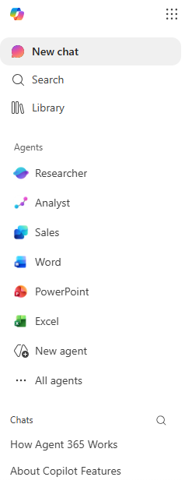
Agents
Get started with agents in Microsoft 365 Copilot
Agents extend what you can do with Microsoft 365 Copilot—you can customize your Copilot experience by connecting to your organization’s knowledge and data sources, as well as by automating and executing business processes.
Leverage agents built by Microsoft that use advanced reasoning like Researcher and Analyst or specialized agents like Facilitator for meeting management.
From Microsoft to trusted third party agents, Agent Store is where you find agents that
are ready to work for you.
Build your own agents with Agent Builder using natural language or pro code tooling with the Microsoft 365 Agent SDK.
Pinned agents
Pin agents to the sidebar for easy access
New agent
Open Agent Builder to create an agent
All agents
Open Agent Store to find additional agents
Note: “UI shown as of May 18, 2026. Product features and visuals may change.”
Notes:
Let’s talk about Copilot Agents!
So, what exactly are Copilot Agents? Think of them as your own personal AI-powered helpers that you can set up to handle specific tasks or workflows for you and your team. Instead of you having to do repetitive or complex work manually, you can have an agent do it for you—kind of like having a digital coworker who never gets tired and is always ready to help.
Here’s how they work:
Agents can be built by Microsoft, by your company, or even by you (if you want to get creative). There are pre-built agents for things like meeting management, research, data analysis, and more. But you can also create custom agents tailored to your team’s unique needs—no coding required! You just describe what you want the agent to do, connect it to the right data sources (like SharePoint, Teams, or other apps), and set a few preferences. The agent then gets to work, automating those tasks in the background.
What are the benefits?
Saves time: Agents can take care of routine or time-consuming tasks, so you can focus on more important work. For example, you could have an agent that automatically gathers project updates, summarizes meeting notes, or even manages surveys for your team.
Reduces errors: Because agents follow the instructions you set, they’re consistent and don’t forget steps—no more missing a detail in a process or forgetting to send a reminder.
Boosts productivity: With agents handling the busywork, you and your team can get more done in less time. It’s like multiplying your team’s capacity without hiring anyone new.
Customizable: You can build agents for almost anything—whether it’s onboarding new employees, tracking project milestones, or even answering common HR questions. And if your needs change, you can tweak your agents anytime.
Connects to your data: Agents can pull information from across your organization’s systems, so they always have the latest info and can give you up-to-date answers or reports.
Bottom line:
Copilot Agents are here to make your work life easier by automating the stuff that slows you down. They’re flexible, powerful, and surprisingly easy to set up. You can find agents in the Agent Store and even build your own with Copilot Studio—using natural language or pro code tooling.

Slide 22









Microsoft Agents
Get started with agents in Microsoft 365
Automate tasks with pre-built agents by Microsoft that are designed for work
Researcher
Analyst
Word
Excel
Premium
Premium
Basic
Basic
Facilitator
Planner
Coaches
PowerPoint
Premium
Premium
Basic
Basic
Notes:
Microsoft offers pre-built agents designed for work, such as:
Skills: Map organizational talent.
Channels: AI teammates for channel conversations.
Survey: Automate survey creation and measurement.
Communities: Support engagement in Viva Engage.
Facilitator: Moderate Teams meetings and notes.
Analyst & Researcher: Advanced reasoning for data analysis and research.
Interpreter: Real-time multilingual translation.
Project Manager: Automate planning and reporting.
Knowledge: Manage SharePoint content. These agents are available in public preview or general availability, and more are coming soon.

Slide 23
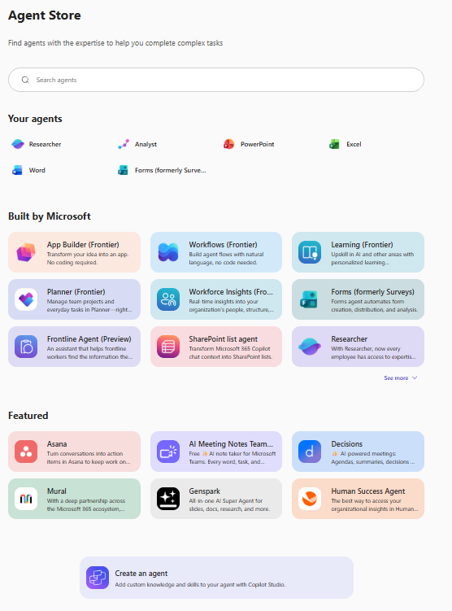
Agent Store
Agent Store provides teams instant access to purpose‑built AI agents that solve real work problems—without the need for development —so organizations can move faster.
It is a governed, enterprise‑ready marketplace where agents are discoverable, secure, and centrally managed, reducing shadow AI while helping to ensure agents integrate cleanly with existing identity, data, and admin controls.
Note: “UI shown as of May 18, 2026. Product features and visuals may change.”
Notes:
Let’s talk about Copilot Agents!
So, what exactly are Copilot Agents? Think of them as your own personal AI-powered helpers that you can set up to handle specific tasks or workflows for you and your team. Instead of you having to do repetitive or complex work manually, you can have an agent do it for you—kind of like having a digital coworker who never gets tired and is always ready to help.
Here’s how they work:
Agents can be built by Microsoft, by your company, or even by you (if you want to get creative). There are pre-built agents for things like meeting management, research, data analysis, and more. But you can also create custom agents tailored to your team’s unique needs—no coding required! You just describe what you want the agent to do, connect it to the right data sources (like SharePoint, Teams, or other apps), and set a few preferences. The agent then gets to work, automating those tasks in the background.
What are the benefits?
Saves time: Agents can take care of routine or time-consuming tasks, so you can focus on more important work. For example, you could have an agent that automatically gathers project updates, summarizes meeting notes, or even manages surveys for your team.
Reduces errors: Because agents follow the instructions you set, they’re consistent and don’t forget steps—no more missing a detail in a process or forgetting to send a reminder.
Boosts productivity: With agents handling the busywork, you and your team can get more done in less time. It’s like multiplying your team’s capacity without hiring anyone new.
Customizable: You can build agents for almost anything—whether it’s onboarding new employees, tracking project milestones, or even answering common HR questions. And if your needs change, you can tweak your agents anytime.
Connects to your data: Agents can pull information from across your organization’s systems, so they always have the latest info and can give you up-to-date answers or reports.
Bottom line:
Copilot Agents are here to make your work life easier by automating the stuff that slows you down. They’re flexible, powerful, and surprisingly easy to set up. You can find agents in the Agent Store and even build your own with Copilot Studio—using natural language or pro code tooling.

Slide 24
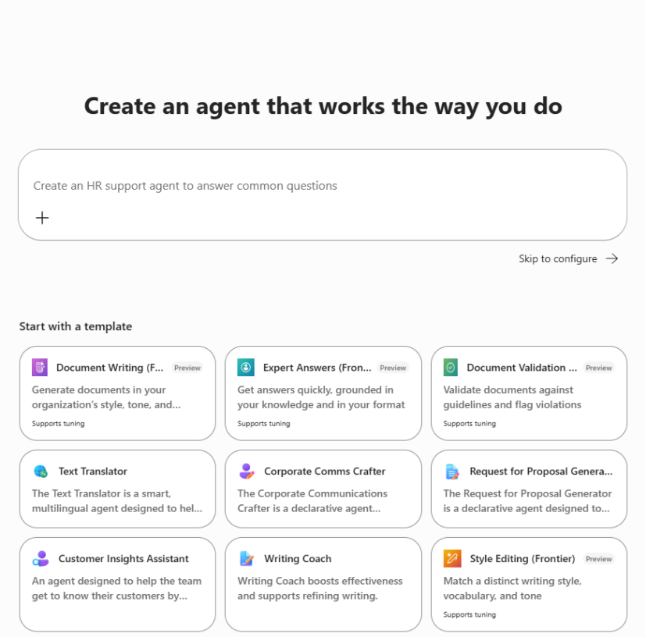
Create custom agents
Build your own agent with Microsoft 365 Copilot
Have a more specific task to get done? Create a custom agent easily – no coding needed.
Open Agent Builder by expanding the “Agents” option in the Copilot Chat menu and selecting “New agent”.
Create an agent from scratch by describing what you’d like your agent to do or select “Skip to Configure” to manually enter configuration information.
Or Start with an agent template by selecting “Create an agent” in the right-side pane of Copilot Chat and selecting one of the templates, like Prompt Coach or Writing Coach.
Note: “UI shown as of May 18, 2026. Product features and visuals may change.”
Notes:
If you have a specific task, you can easily create a custom agent—no coding required.
Open Copilot Studio, expand the “Agents” option, and select “Create agent.”
Start with a template or build from scratch by describing what you want your agent to do.
Custom agents can connect to team data sources, like SharePoint, to answer questions about team documents.

Slide 25
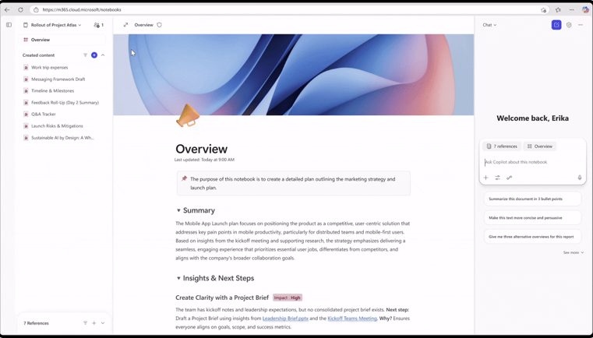
Copilot Notebooks (Premium only)
Get started with Microsoft 365 Copilot Notebooks
Sometimes, getting all your thoughts and references organized for a project or task is the hardest part of getting started.
Copilot Notebooks gives you a head start by using AI to gather relevant content in one place – including notes, documents, websites, and meeting recordings. It also provides relevant actions and insights based on the content.
Copilot is grounded in the Notebook, which holds diverse types of content in a single workspace, resulting in more relevant responses.
AI-generated podcast style summaries of your Notebook content help you quickly catch up.
Intelligent suggestions recommend additional content and updates to your source material automatically reflect in the Notebook.
Notes:
Let’s talk about Copilot Notebooks!
So, what are Copilot Notebooks? Think of them as your digital workspace for organizing everything related to a project or task. Instead of having your notes in one place, your files in another, and your meeting recordings somewhere else, Notebooks let you pull all that content together in one spot. It’s like having a super-organized binder, but way smarter and powered by AI.
Here’s how it works:
You start by creating a new notebook and giving it a name—maybe for a project, a client, or even just a big meeting you’re prepping for. Then, you can add all sorts of references: notes, documents, websites, Copilot Chat conversations, and even meeting recordings. Everything you need is right there, so you’re not jumping between apps or digging through folders.
But here’s where it gets really cool: Copilot Notebooks use AI to help you make sense of all that content. You can ask questions right in your notebook’s prompt box, and Copilot will analyze everything you’ve added to give you answers and insights. Need a summary of all the meeting notes? Want to draft a proposal based on your research? Just ask, and Copilot pulls it together for you.
What are the benefits?
Stay organized: No more scattered files or forgotten notes. Everything for your project is in one place, and you can add or update content as you go.
Save time: Instead of searching through emails, chats, and documents, you can just ask Copilot to find what you need or summarize the latest updates.
Smarter insights: Copilot can spot connections between your content, suggest additional resources, and even generate podcast-style audio summaries so you can catch up on the go.
Easy collaboration: You can share your notebook with teammates, so everyone’s working from the same set of materials and can contribute their own notes or files.
Real-life example:
Let’s say you’re working on a marketing campaign. You can create a notebook, add your brainstorming notes, campaign documents, relevant emails, and even recordings from kickoff meetings. When you need to prep a status update or answer a tough question, just ask Copilot in the notebook and it’ll pull together the info you need—no more scrambling or piecing things together at the last minute.
Bottom line:
Copilot Notebooks are all about making your work life easier and more organized. They help you keep everything in one place, get smarter answers faster, and collaborate more effectively with your team.

Slide 26
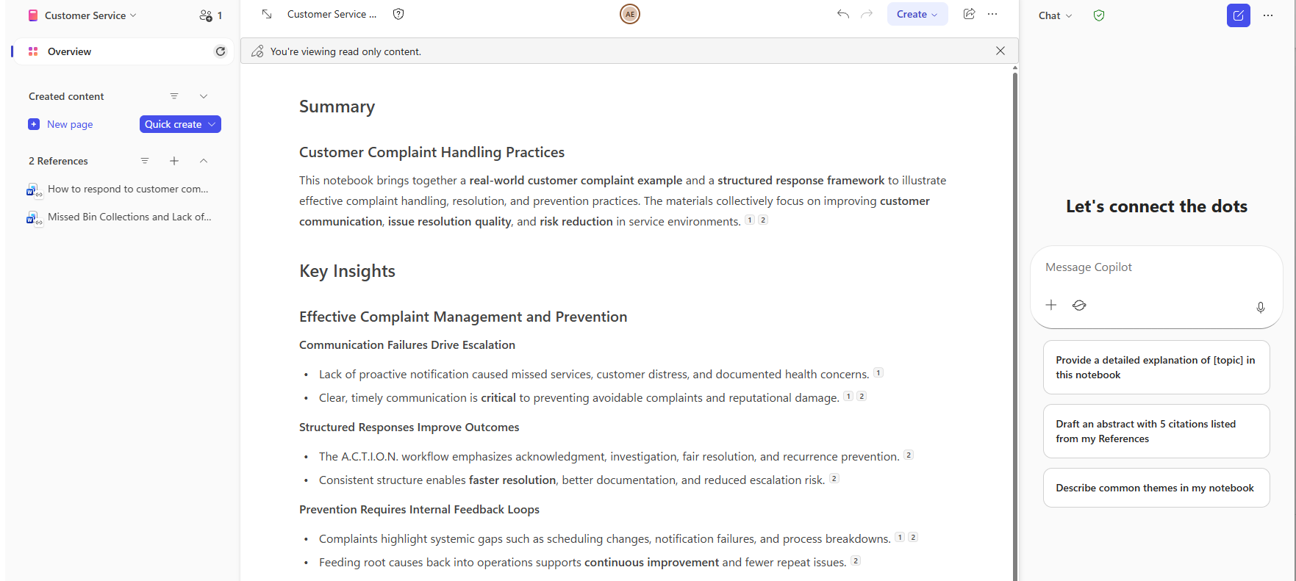
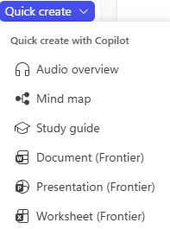
Get to know Notebooks
Notebook name and sharing
Name your notebooks to make them easy to identify. Invite people to collaborate in the notebook.
Page name
Rename individual pages and set the data label. You can also close or open the Copilot chat pane here.
Page controls
Access version history for the page, turn your page into a document, share your page, or add it to the notebook as a reference.
Overview
AI generated overview of your content can be refreshed at any time.
Created content
Use this section to add pages to your notebook or generate AI content with Quick create.
Chat pane
Use Copilot to interact with your notebook content. Knowledge is limited to the documents in the notebook.
Add content to the chat
Use Researcher in the chat
Use dictation
References
Link external content to your notebook
Current page
The viewing pane for the content in your notebook. Either the AI Overview or pages you create.
Note: “UI shown as of May 18, 2026. Product features and visuals may change.”
Notes:
Let’s get to know Copilot Notebooks a little better!
One really cool feature is the audio overview. If you’re short on time, you can actually listen to a quick audio summary of your notebook’s content, so you can catch up while you’re on the go or multitasking.
Use the chat pane to ask Copilot questions that are limited to just the documents in your notebook. This means you get super-relevant answers based only on the content you’ve added. And just like with Copilot Agents, you can give Notebooks instructions about the kind of responses you want—so Copilot knows exactly how to help you.
You can also organize your content into episodes or chapters, making it easy to break big projects into manageable pieces.

Slide 27
Understand your content in new ways with Copilot Notebooks
Copilot Notebooks are AI‑powered workspaces built on your reference materials, bringing your project context together in one place for you, your team, and Copilot to collaborate¹.
Interactive Mind Map
Study Guides
Podcast Creation
Presentation Creation
Make sense of your complex work
Explore your notebook’s content and see how key themes, concepts, or topics connect visually through an interactive mind map.
Generate a map of key topics and relationships from your notebook. See connections, view quick summaries of individual¹ nodes, and ask Copilot to help explain a concept further.
Learn from your notebook
Start with a summary, explore
deep-dive topic pages, and test
your knowledge with flashcards and quizzes.
Whether you’re preparing for a meeting, onboarding on a new project, or learning unfamiliar material, Copilot Notebooks can help you get up to speed and build your expertise.
Discover through listening
Create an AI-powered audio overview that transforms the content of your notebook into a dynamic, audio experience.
Curate the listening experience with customizable format, style, and duration, and guide the content with natural language requests.
Turn notes into decks
Create a PowerPoint deck with the PowerPoint agent, which can pull from notes, references, and structure already in your notebook to draft slides that are consistent, ready to refine, and preloaded with visuals.
Choose the primary focus, level of detail, slide deck length, and design theme to create a presentation for your unique request.
¹ Copilot Notebooks: Enhancements to support creation, collaboration and learning

Slide 28
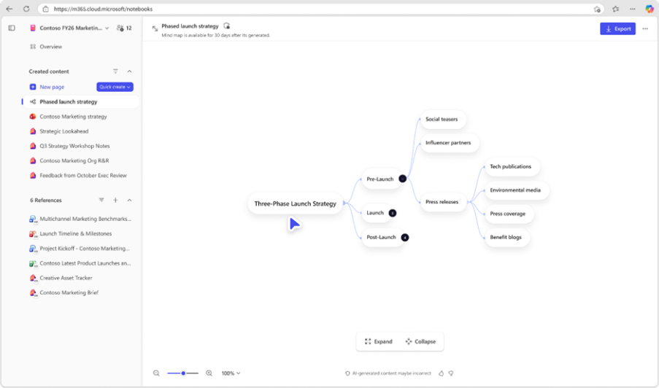
Interactive Mind Map
Make sense of your complex work
Explore your notebook’s content and see how key themes, concepts, or topics connect visually through an interactive mind map¹.
Generate a map of key topics and relationships from your notebook. See connections, view quick summaries of individual nodes, and ask Copilot to help explain a concept further¹.
¹ Copilot Notebooks: Enhancements to support creation, collaboration and learning

Slide 29
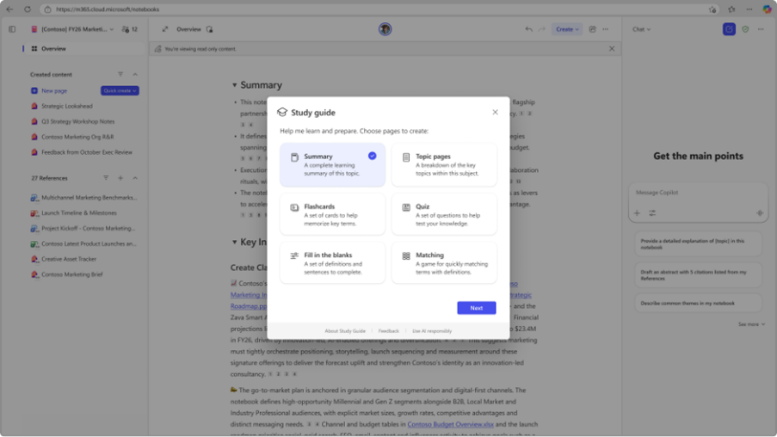
Study Guides
Learn from your Notebook
Start with a summary, explore
deep-dive topic pages, and test
your knowledge with flashcards and quizzes¹.
Whether you’re preparing for a meeting, onboarding on a new project, or learning unfamiliar material, Copilot Notebooks can help you get up to speed and build your expertise.
¹ Copilot Notebooks: Enhancements to support creation, collaboration and learning

Slide 30
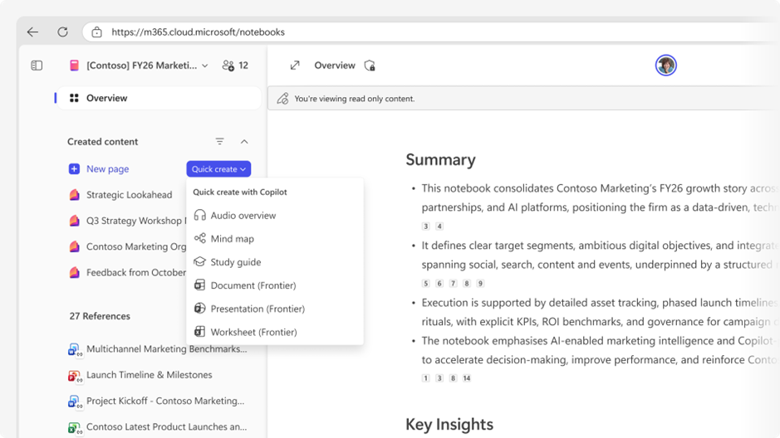
Podcast Creation
Discover through listening
Create an AI-powered audio overview that transforms the content of your notebook into a dynamic, audio experience¹.
Curate the listening experience with customizable format, style, and duration¹, and guide the content with natural language requests.
¹ Copilot Notebooks: Enhancements to support creation, collaboration and learning

Slide 31
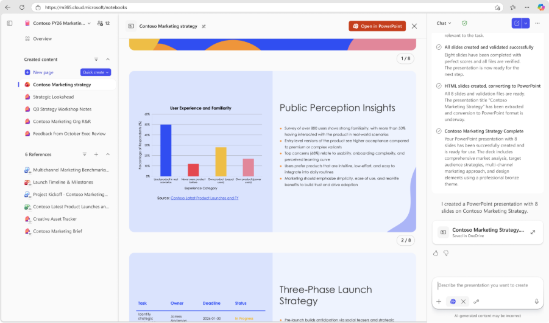
Presentation Creation
Turn notes into decks
Create a PowerPoint deck with the PowerPoint agent, which can pull from notes, references, and structure already in your notebook to draft slides that are consistent, ready to refine, and preloaded with visuals¹.
Choose the primary focus, level of detail, slide deck length, and design theme to create a presentation for your unique request.
¹ Copilot Notebooks: Enhancements to support creation, collaboration and learning

Slide 32
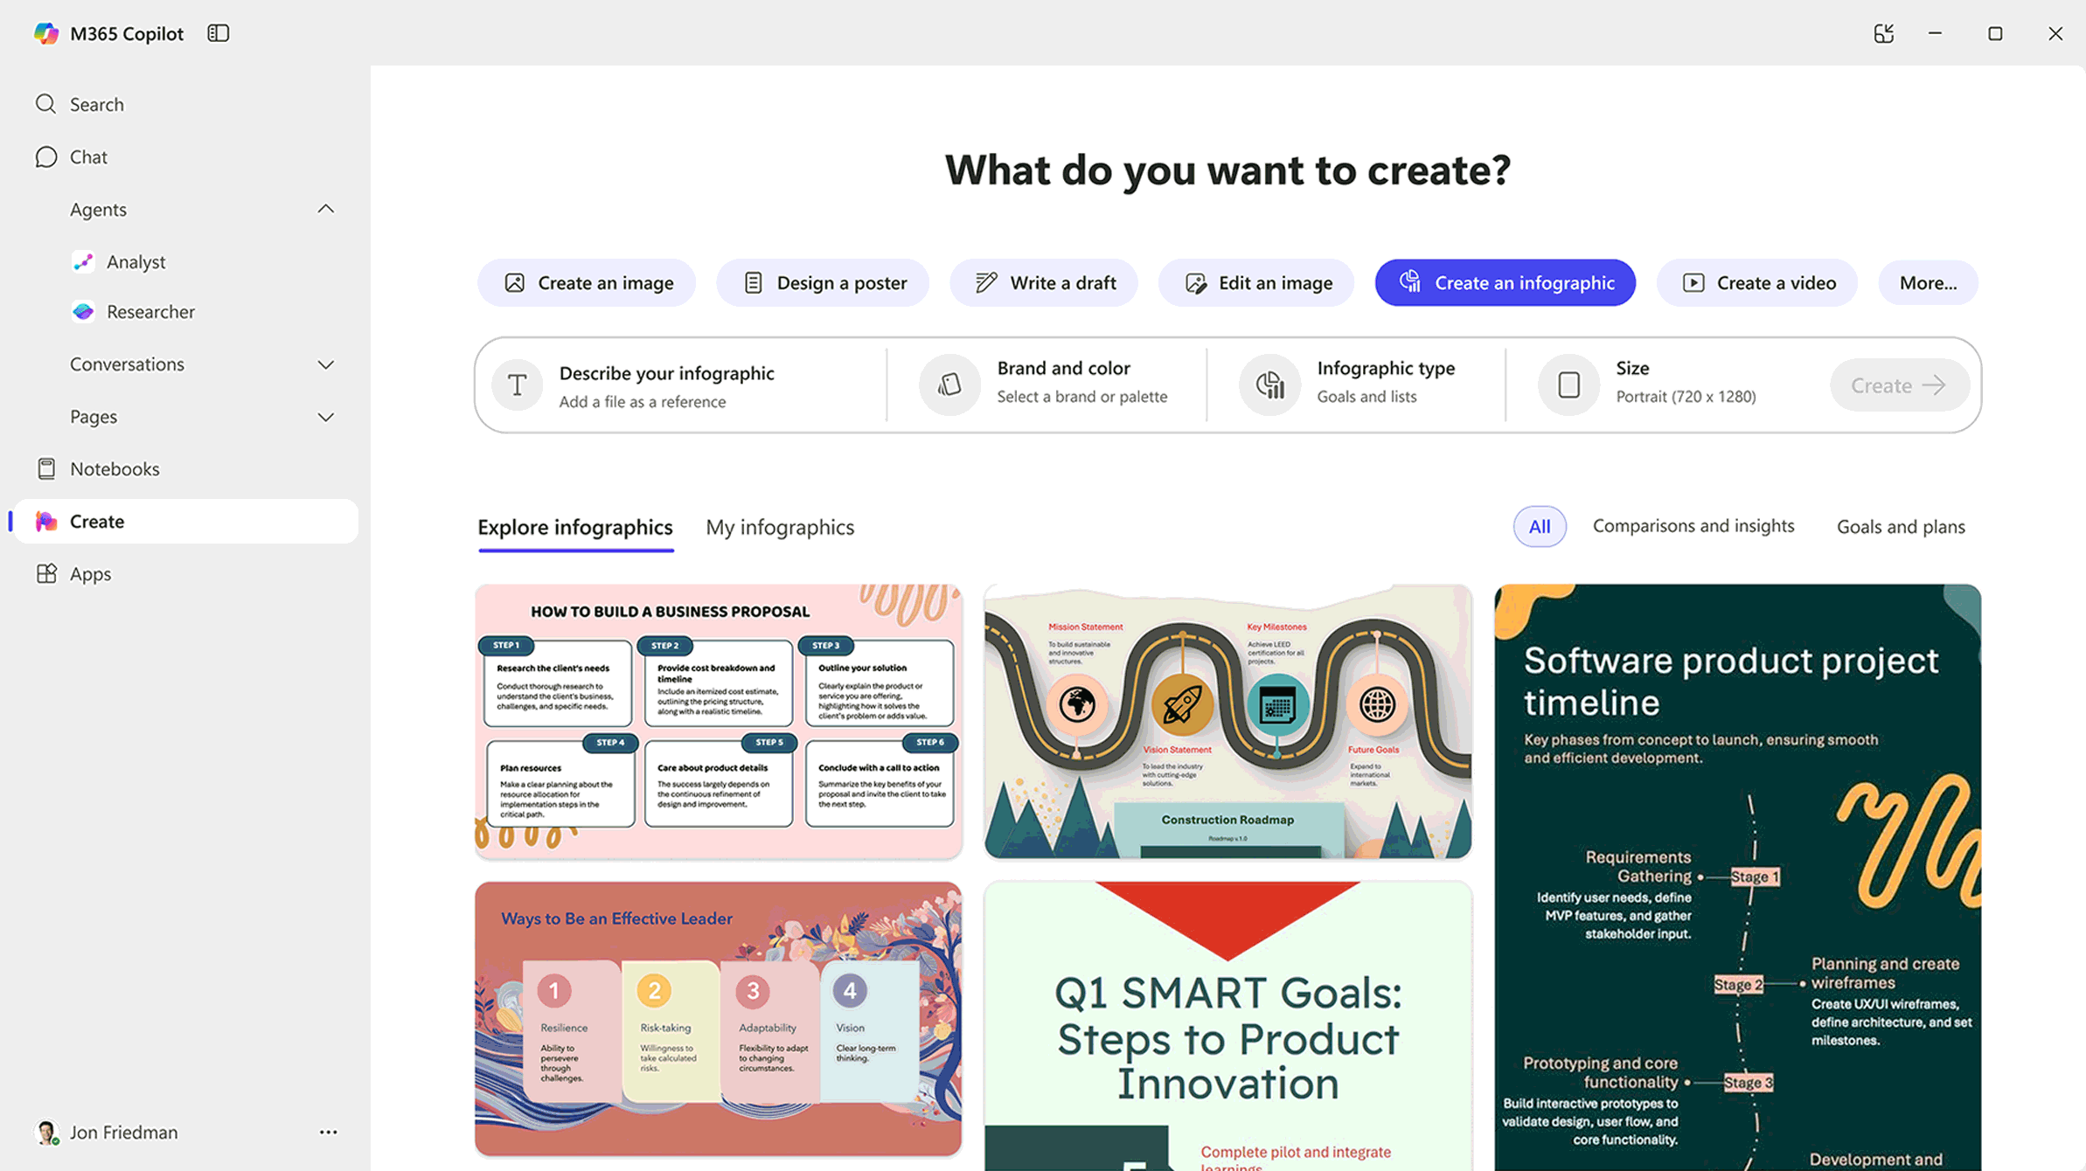
Create
Get started with Microsoft 365 Copilot Create
Create uses AI to generate and edit content like images, videos, documents, podcasts, and surveys. To make things even easier, Create is tailored to your company, so you can use it to create a flyer with your company name and branding automatically applied.
Design and edit a wide range of visual artifacts in a creative process grounded on Work IQ and files uploaded by you.
Choose from templates or create brand kits that include your company’s logos,
color palettes, fonts, and more, ensuring brand consistency across all creative outputs.
Fine tune your work with built-in visual editing tools that make it easy to edit text, add effects, and make sophisticated adjustments to get the asset you need.
Notes:
Let’s talk about Copilot Create—this is the part of Microsoft 365 Copilot that’s all about unleashing your creativity and making content creation way easier and a lot more fun.
So, what is Copilot Create? Think of it as your AI-powered creative assistant. Whether you need to make images, videos, documents, podcasts, or even surveys, Create is designed to help you get started quickly and produce professional-looking results—even if you’re not a designer or a content expert.
One of the coolest things about Create is how it’s tailored to your company. You can use your organization’s branding—like logos, colors, and fonts—automatically in whatever you make. That means your flyers, presentations, and graphics always look consistent and on-brand, without you having to fiddle with formatting every time.
You don’t have to start from scratch, either. There are thousands of templates to choose from, so if you need a quick social media post, a report cover, or a new slide deck, you can just pick a template and customize it. And if you want to get really creative, you can use the built-in editing tools to tweak text, add effects, or fine-tune your visuals until they’re just right.
Another big benefit is how Create brings everything together in one place. You can generate content, edit it, and even collaborate with your team—all without jumping between different apps or tools. If you want to turn your ideas into something visual, just describe what you want in plain language, and Copilot will help you bring it to life.
Bottom line: Copilot Create is here to make content creation faster, easier, and a lot less intimidating. It’s perfect for anyone who wants to make great-looking materials without spending hours on design. So next time you need to create something—whether it’s a graphic, a video, or a document—give Copilot Create a try. You might be surprised at how much time you save and how good your work looks!

Slide 33
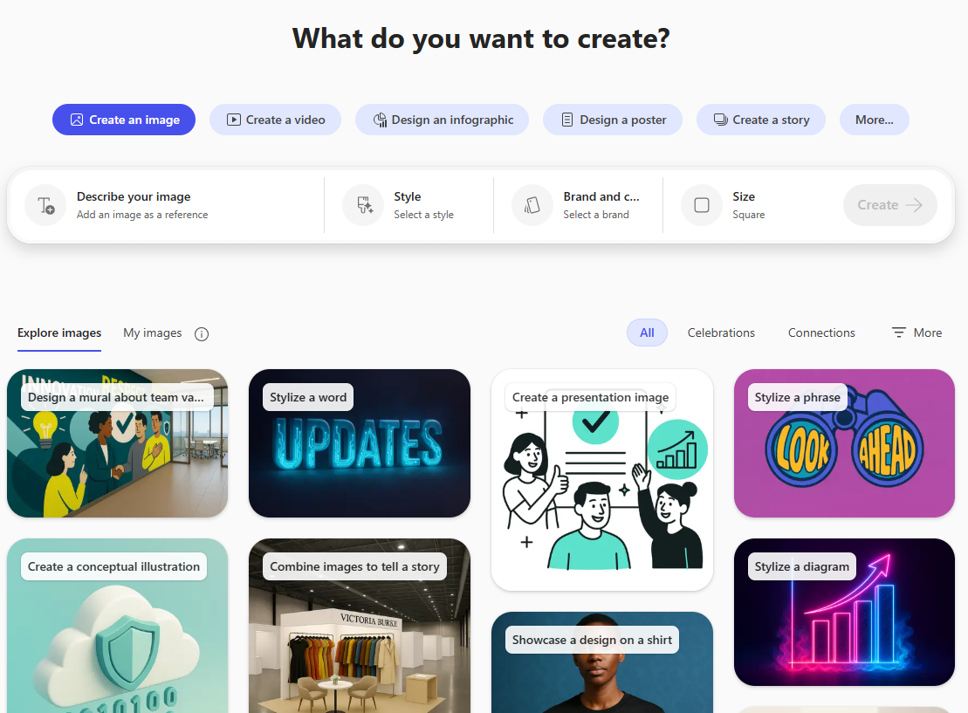
Get to know Create
Content type
Select the type of content you would like to create
Instructions
Using simple language or the selections provided to tell Copilot about the content you want to create
Filter selections
Filters to view the selected content
Suggested prompts
Select from existing content prompts to start with a
particular style
Note: “UI shown as of May 18, 2026. Product features and visuals may change.”
Notes:
When you open Create, you’ll see you can pick from existing content prompts to get started with a certain style or type of content. Just use simple language to tell Copilot what you want to make—whether it’s a graphic, a document, or something else.
There are filters to help you organize and view your content, which makes managing creative projects a breeze. The whole idea is to streamline your creative process, so you spend less time fiddling with formatting and more time actually creating.

