Slide 1
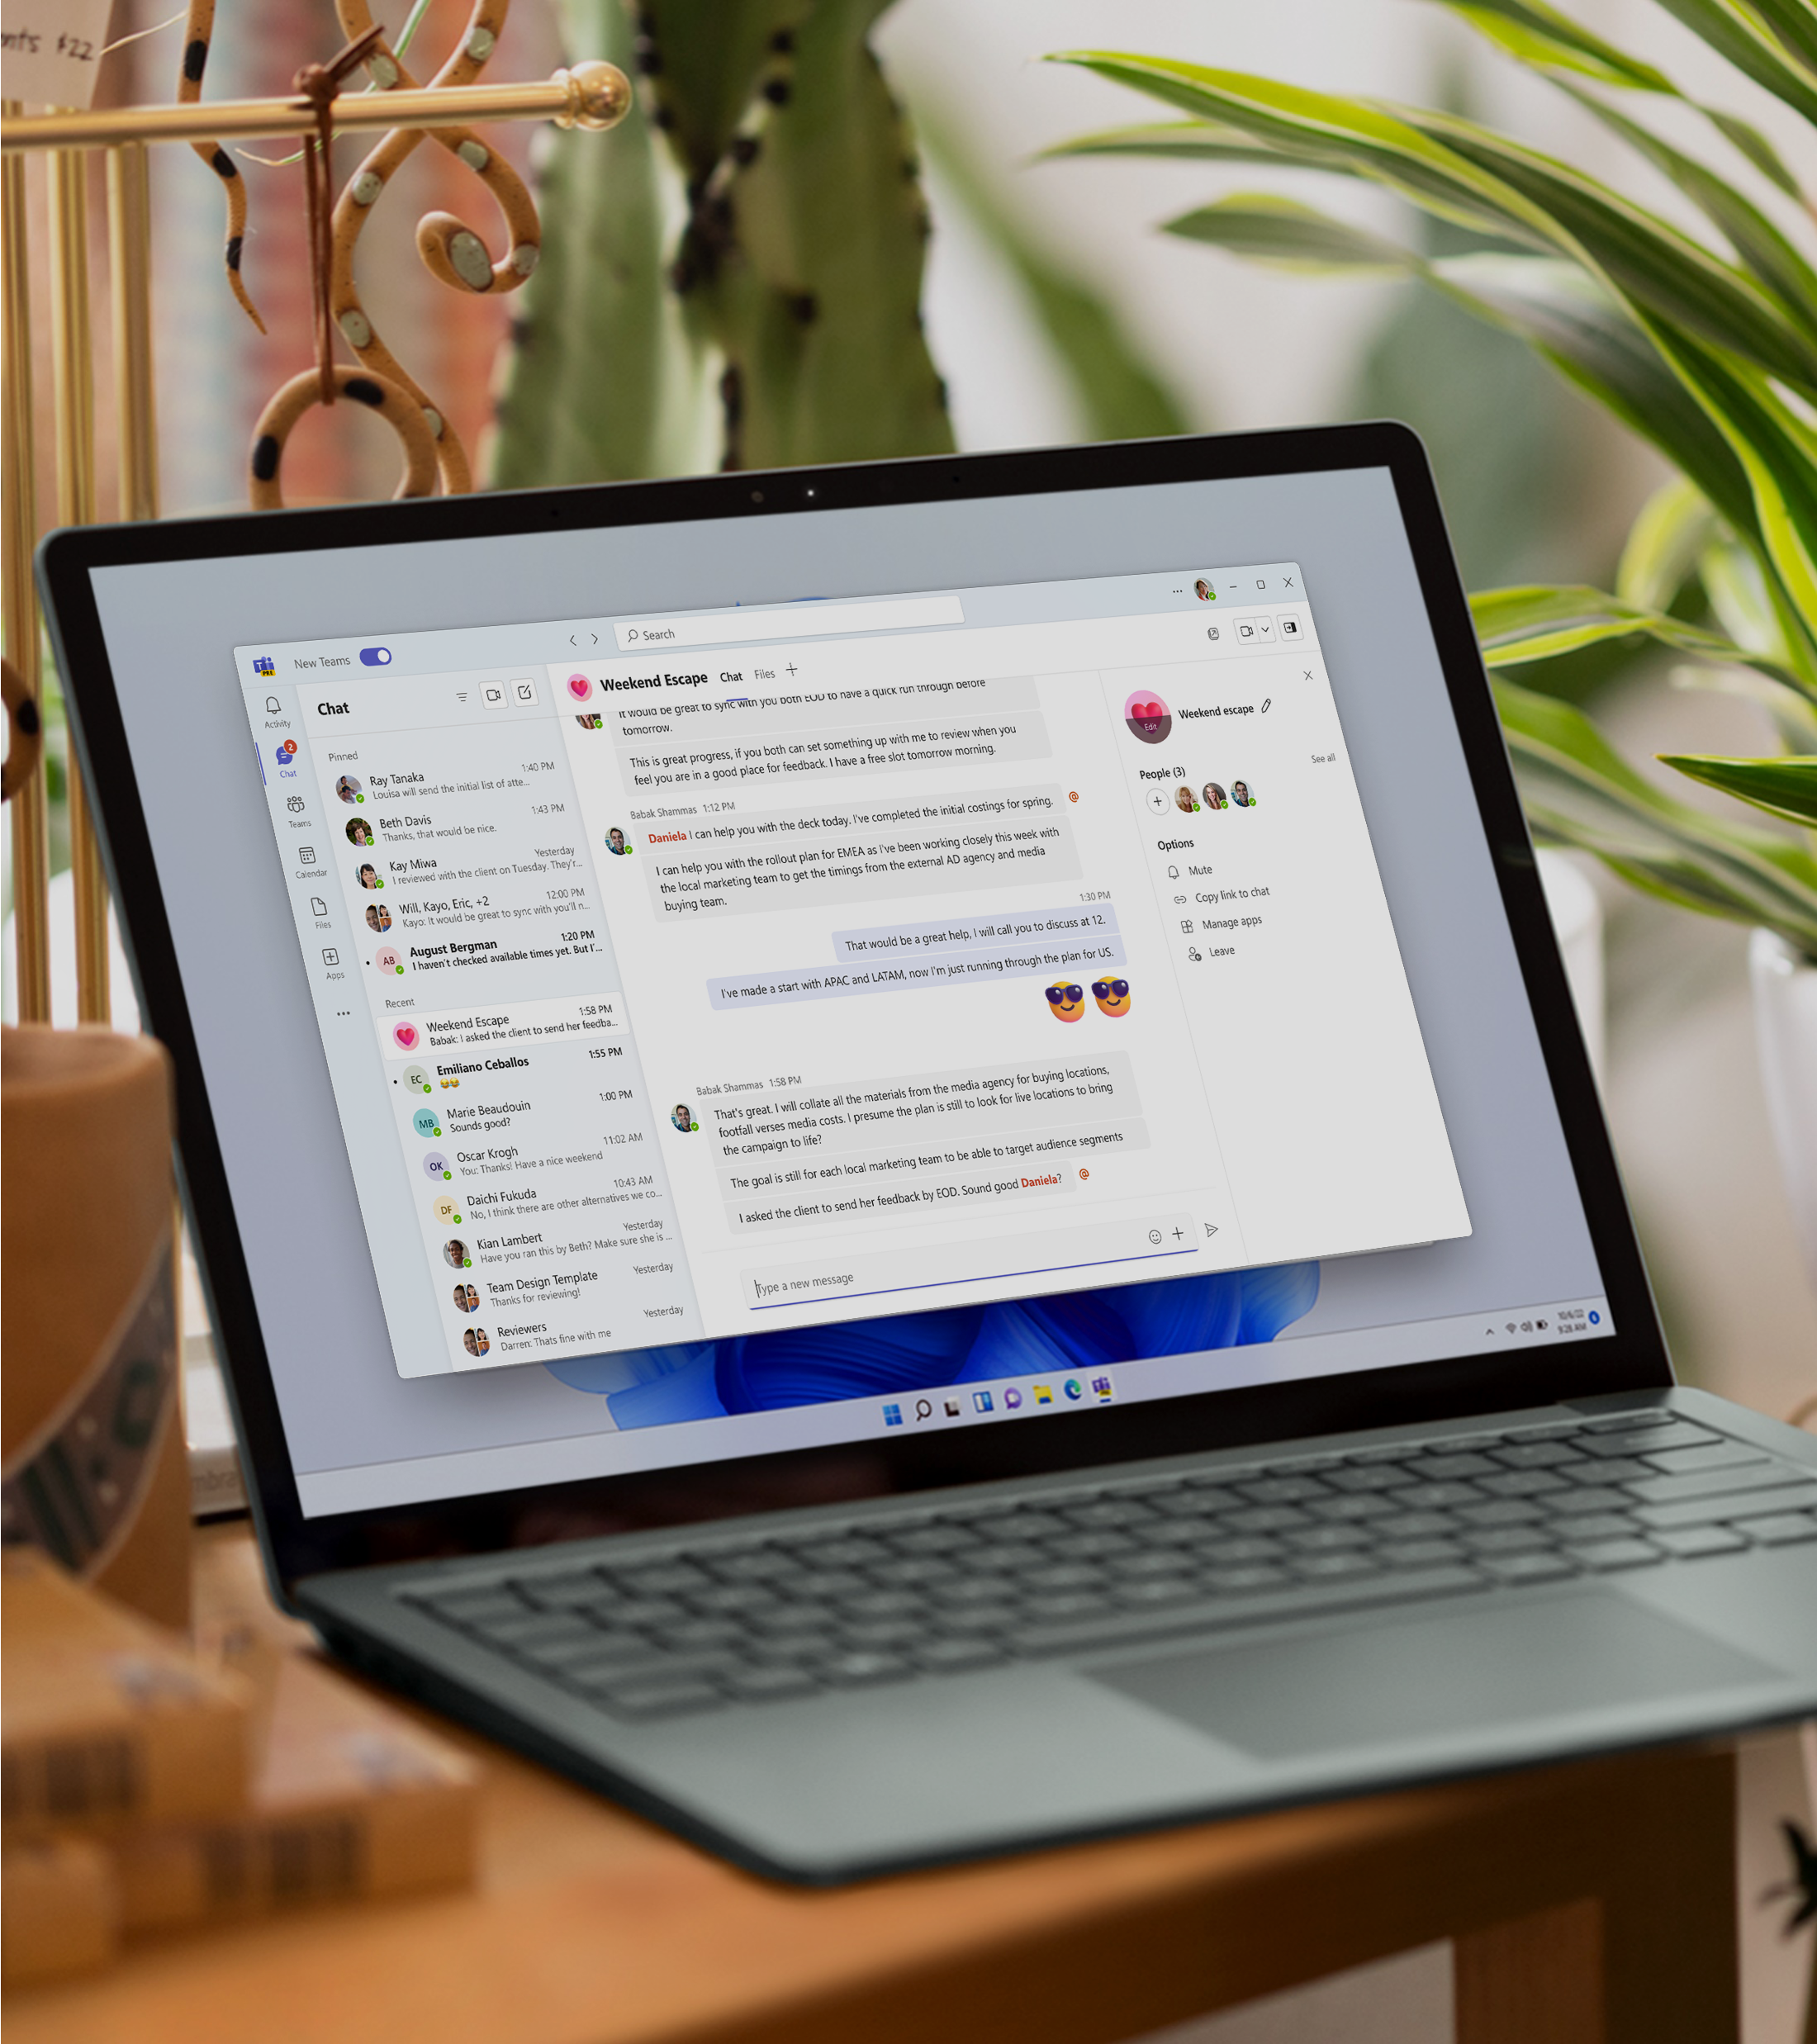
Say hello to the new Microsoft Teams
A guide for Champions, trainers, IT pros, tenant admins, and the Help Desk for all things new in Microsoft Teams

Slide 2






New Teams is now generally available
We have made notable progress since the launch of new Teams in public preview. New Teams now has full feature parity for almost all features.
Faster
The app will be up to twice as fast while consuming up to 50% fewer resources
Simpler
A more polished, responsive UX that’s easier to navigate and get more done
Smarter
The foundation for next-generation AI experiences to help you work smarter and level up your productivity
More flexible
Innovations that streamline multiple tenants or accounts and enable seamless cross-tenant communication
This e-book is meant
to help Champions, trainers, IT pros, tenant admins, and the Help Desk get started with the new Teams and support their end users.
02 | Introducing the new Microsoft Teams

Slide 3

Switch to new Teams by flipping the toggle, it’s easy!
Upgrading to new Teams is quick and seamless – no migration is required! Classic Teams users will be automatically upgraded to new Teams in the coming months. To get started with new Teams today, users can simply flip the toggle in the classic Teams app.
For admins:
Learn about the new Teams release schedule for your organization:
General availability: Windows and Mac, including education.
  End users will start seeing the "Try the new Teams" toggle and new Teams will become the default app.
Public Preview: VDI and government cloud (GCC and GCC-High).
  Educate users that the toggle is available now.
Learn more
Enable new Teams for your organization
New Teams rollout schedule
Technical documentation with installation instructions
End user guidance
03 | Introducing the new Microsoft Teams

Slide 4
A high-performing, more secure Microsoft Teams
Years of research, benchmarking, and prototypes helped us find the right modern tech to deliver a high-performing Teams app that’s also more secure and easier to manage.
In the new Teams, users can switch between apps, respond to chat messages, and join meetings and calls more quickly while using less battery and memory.
Classic Teams
New Teams¹
Result
AngularJS
for web dev framework
2X faster²
Smaller footprint
Greater support for shareable components
Improved responsiveness
React + client data layer
Performance enhancements, which embrace open-source code as part of our development commitment, include:
We’ve also made significant security and manageability enhancements, including:
Streamlined app installation for reduced network and disk space usage
Can be installed and managed remotely via Microsoft Intune and MSIX
Protected and secure folder installation
Hardened security such as Trusted Types and stronger Content Security Policy
Improved meeting quality and stability
Improved on-screen rendering
Expanded performance-optimized infrastructure
HTML + CSS
for custom
controls
Fluent UI
Standard and custom controls for greater responsiveness
Electron
for hosting
50% fewer resources consumed²
50% less memory used²
70% less disk space used²
WebView2
Learn more
Unlocking the Power of Microsoft Teams: Benefits of the New Architecture
¹Each OS leverages native components. ²Maximum possible performance gains.
04 | Introducing the new Microsoft Teams

Slide 5
Performance benchmarking
In March 2023, an independent benchmarking firm, GigaOm, verified the performance improvements of the new Teams. These are some of their findings. See the detailed report here.
Up to
2X
50%
“
The new Microsoft Teams is a lot faster than classic Teams. Navigating and moving between chats, channels and joining meetings has improved a lot. It gives a more stable feel and I look forward to the evolution of it.”
faster
fewer resources used
3X faster installation
2X faster app launch
2X faster to join meetings
1.7X faster chat and channel switching
50% less memory used
70% less disk space used
David Konrad Abramowski Aurtande
Lead Employee Engagement & Hybrid Work
Digital Workplace, Orkla IT
05 | Introducing the new Microsoft Teams

Slide 6
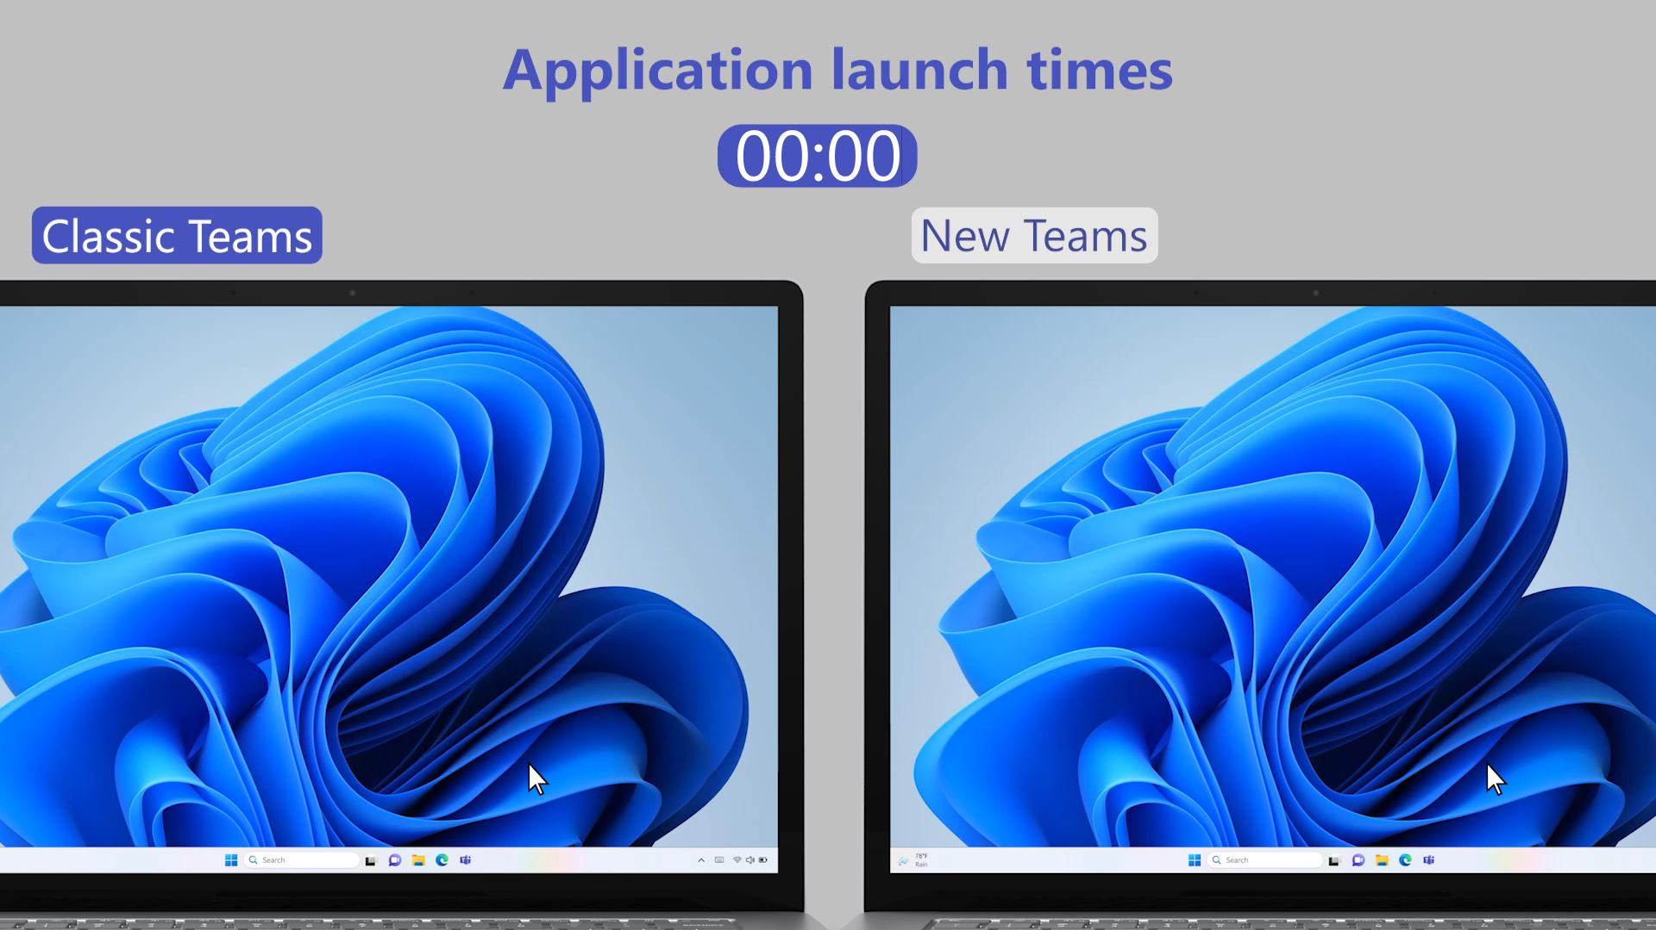
Side-by-side video of classic Teams vs. new Teams
06 | Introducing the new Microsoft Teams

Slide 7

The new
Teams for admins
07 | Introducing the new Microsoft Teams

Slide 8
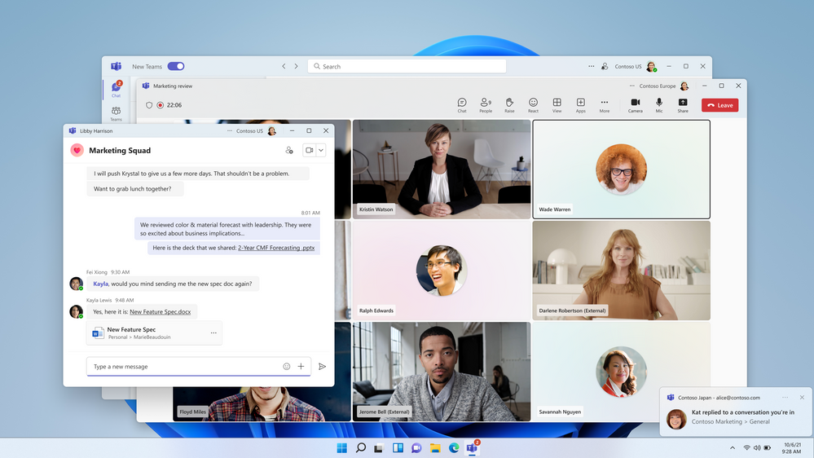

Seamless flexibility for multi-tenant orgs to collaborate
Enhance cross-tenant communications and collaboration experiences in a familiar Teams environment.
Reduced tenant management
Simplify the management of employees across tenants
Side-by-side cross-tenant collaboration
Empower workers to chat seamlessly across, inside, and outside your home organization securely and easily
Improved people search
Give your workers the ability to search for and collaborate with the right people
08 | Introducing the new Microsoft Teams

Slide 9
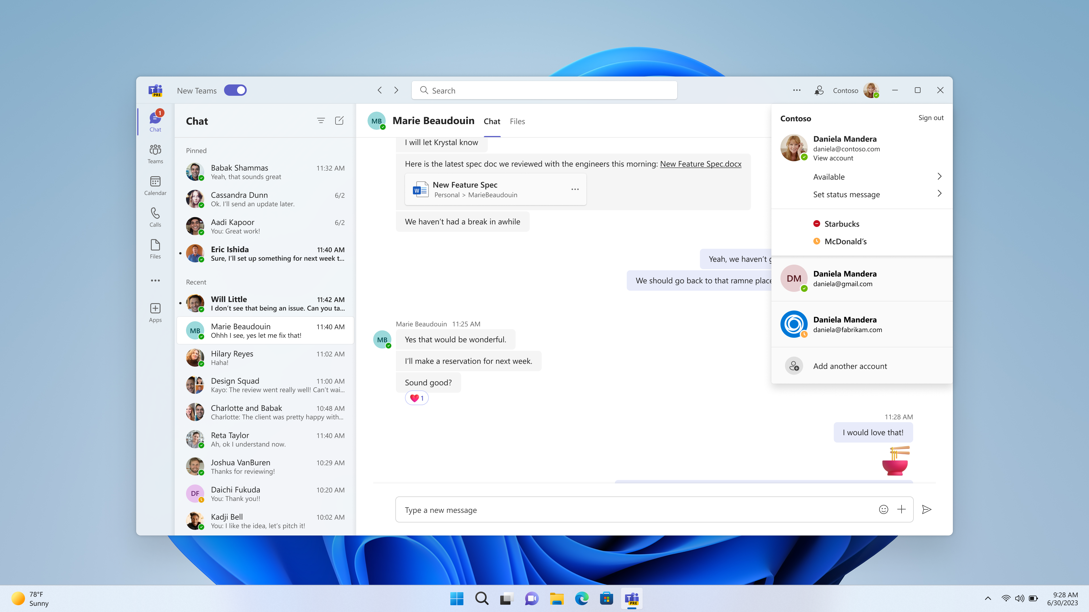
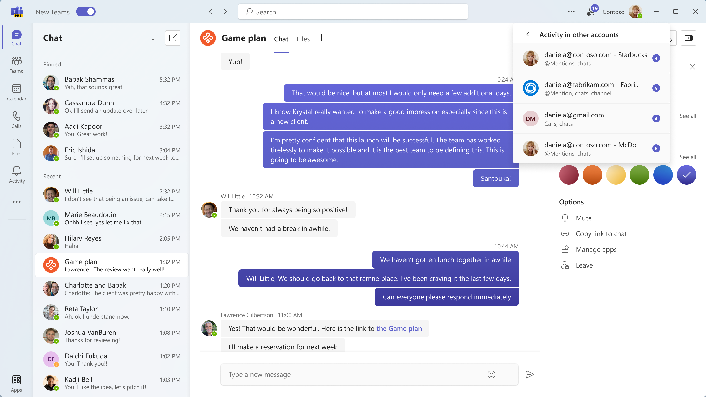
Collaborate across multiple tenants and multiple accounts
Users can easily switch between organizations and accounts to collaborate and communicate across the entire org.​
Eliminates silos
Centrally manage users from across organizations and multiple work or accounts in one place
Fosters collaboration
Help ensure users stay signed into multiple accounts simultaneously to receive real-time notifications
Increases flexibility
Enable seamless engagement across multiple organizations or accounts without disrupting user workflows
Multi-tenant (top), multi-account
09 | Introducing the new Microsoft Teams

Slide 10

The new Teams for Help Desk
10 | Introducing the new Microsoft Teams

Slide 11

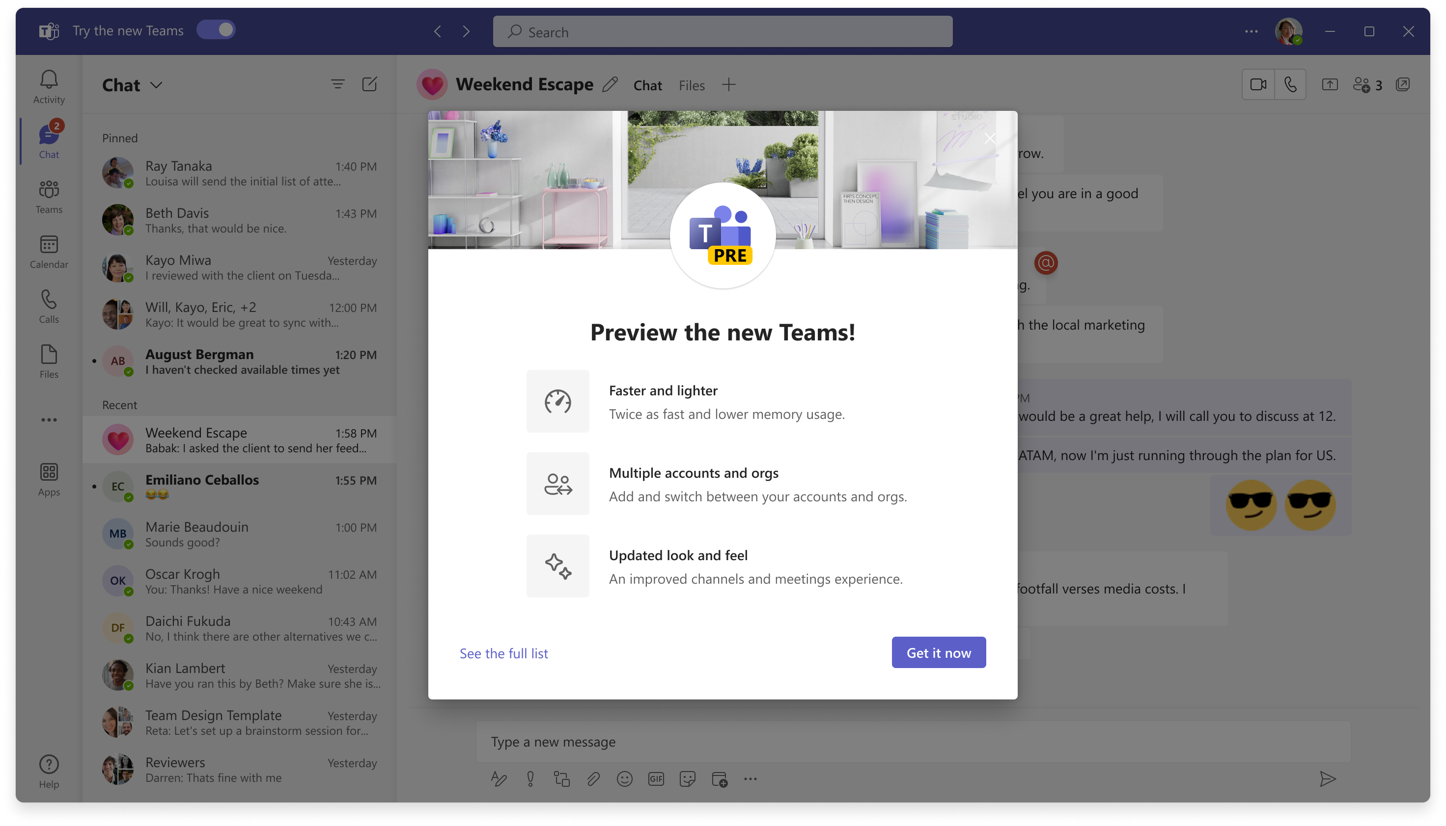
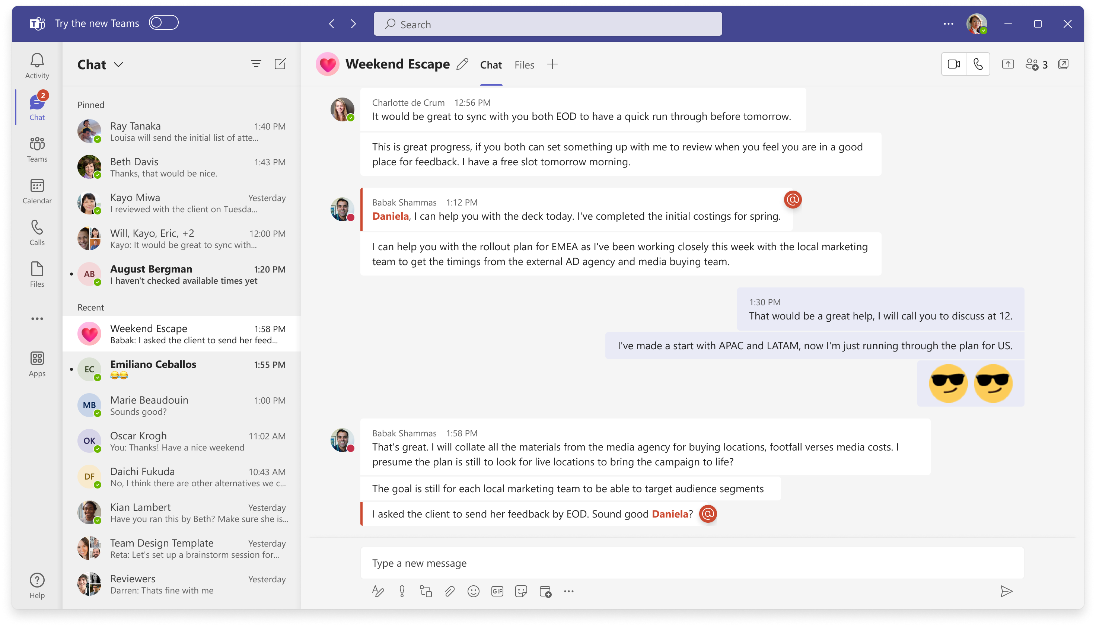


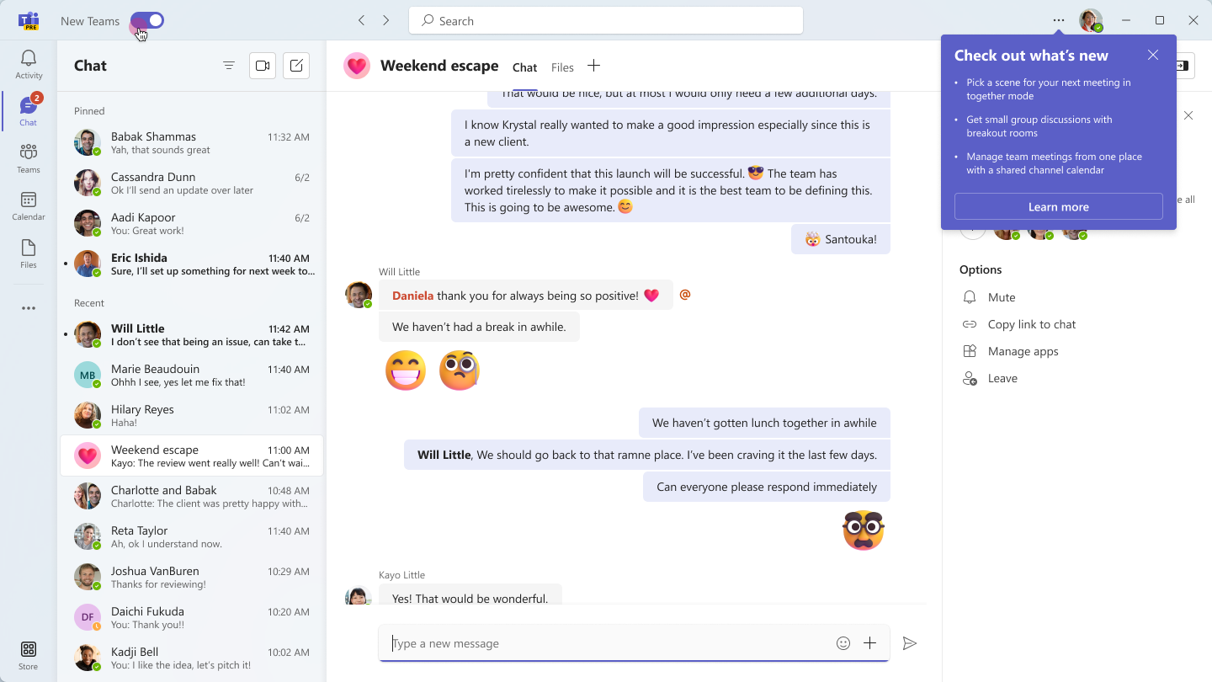
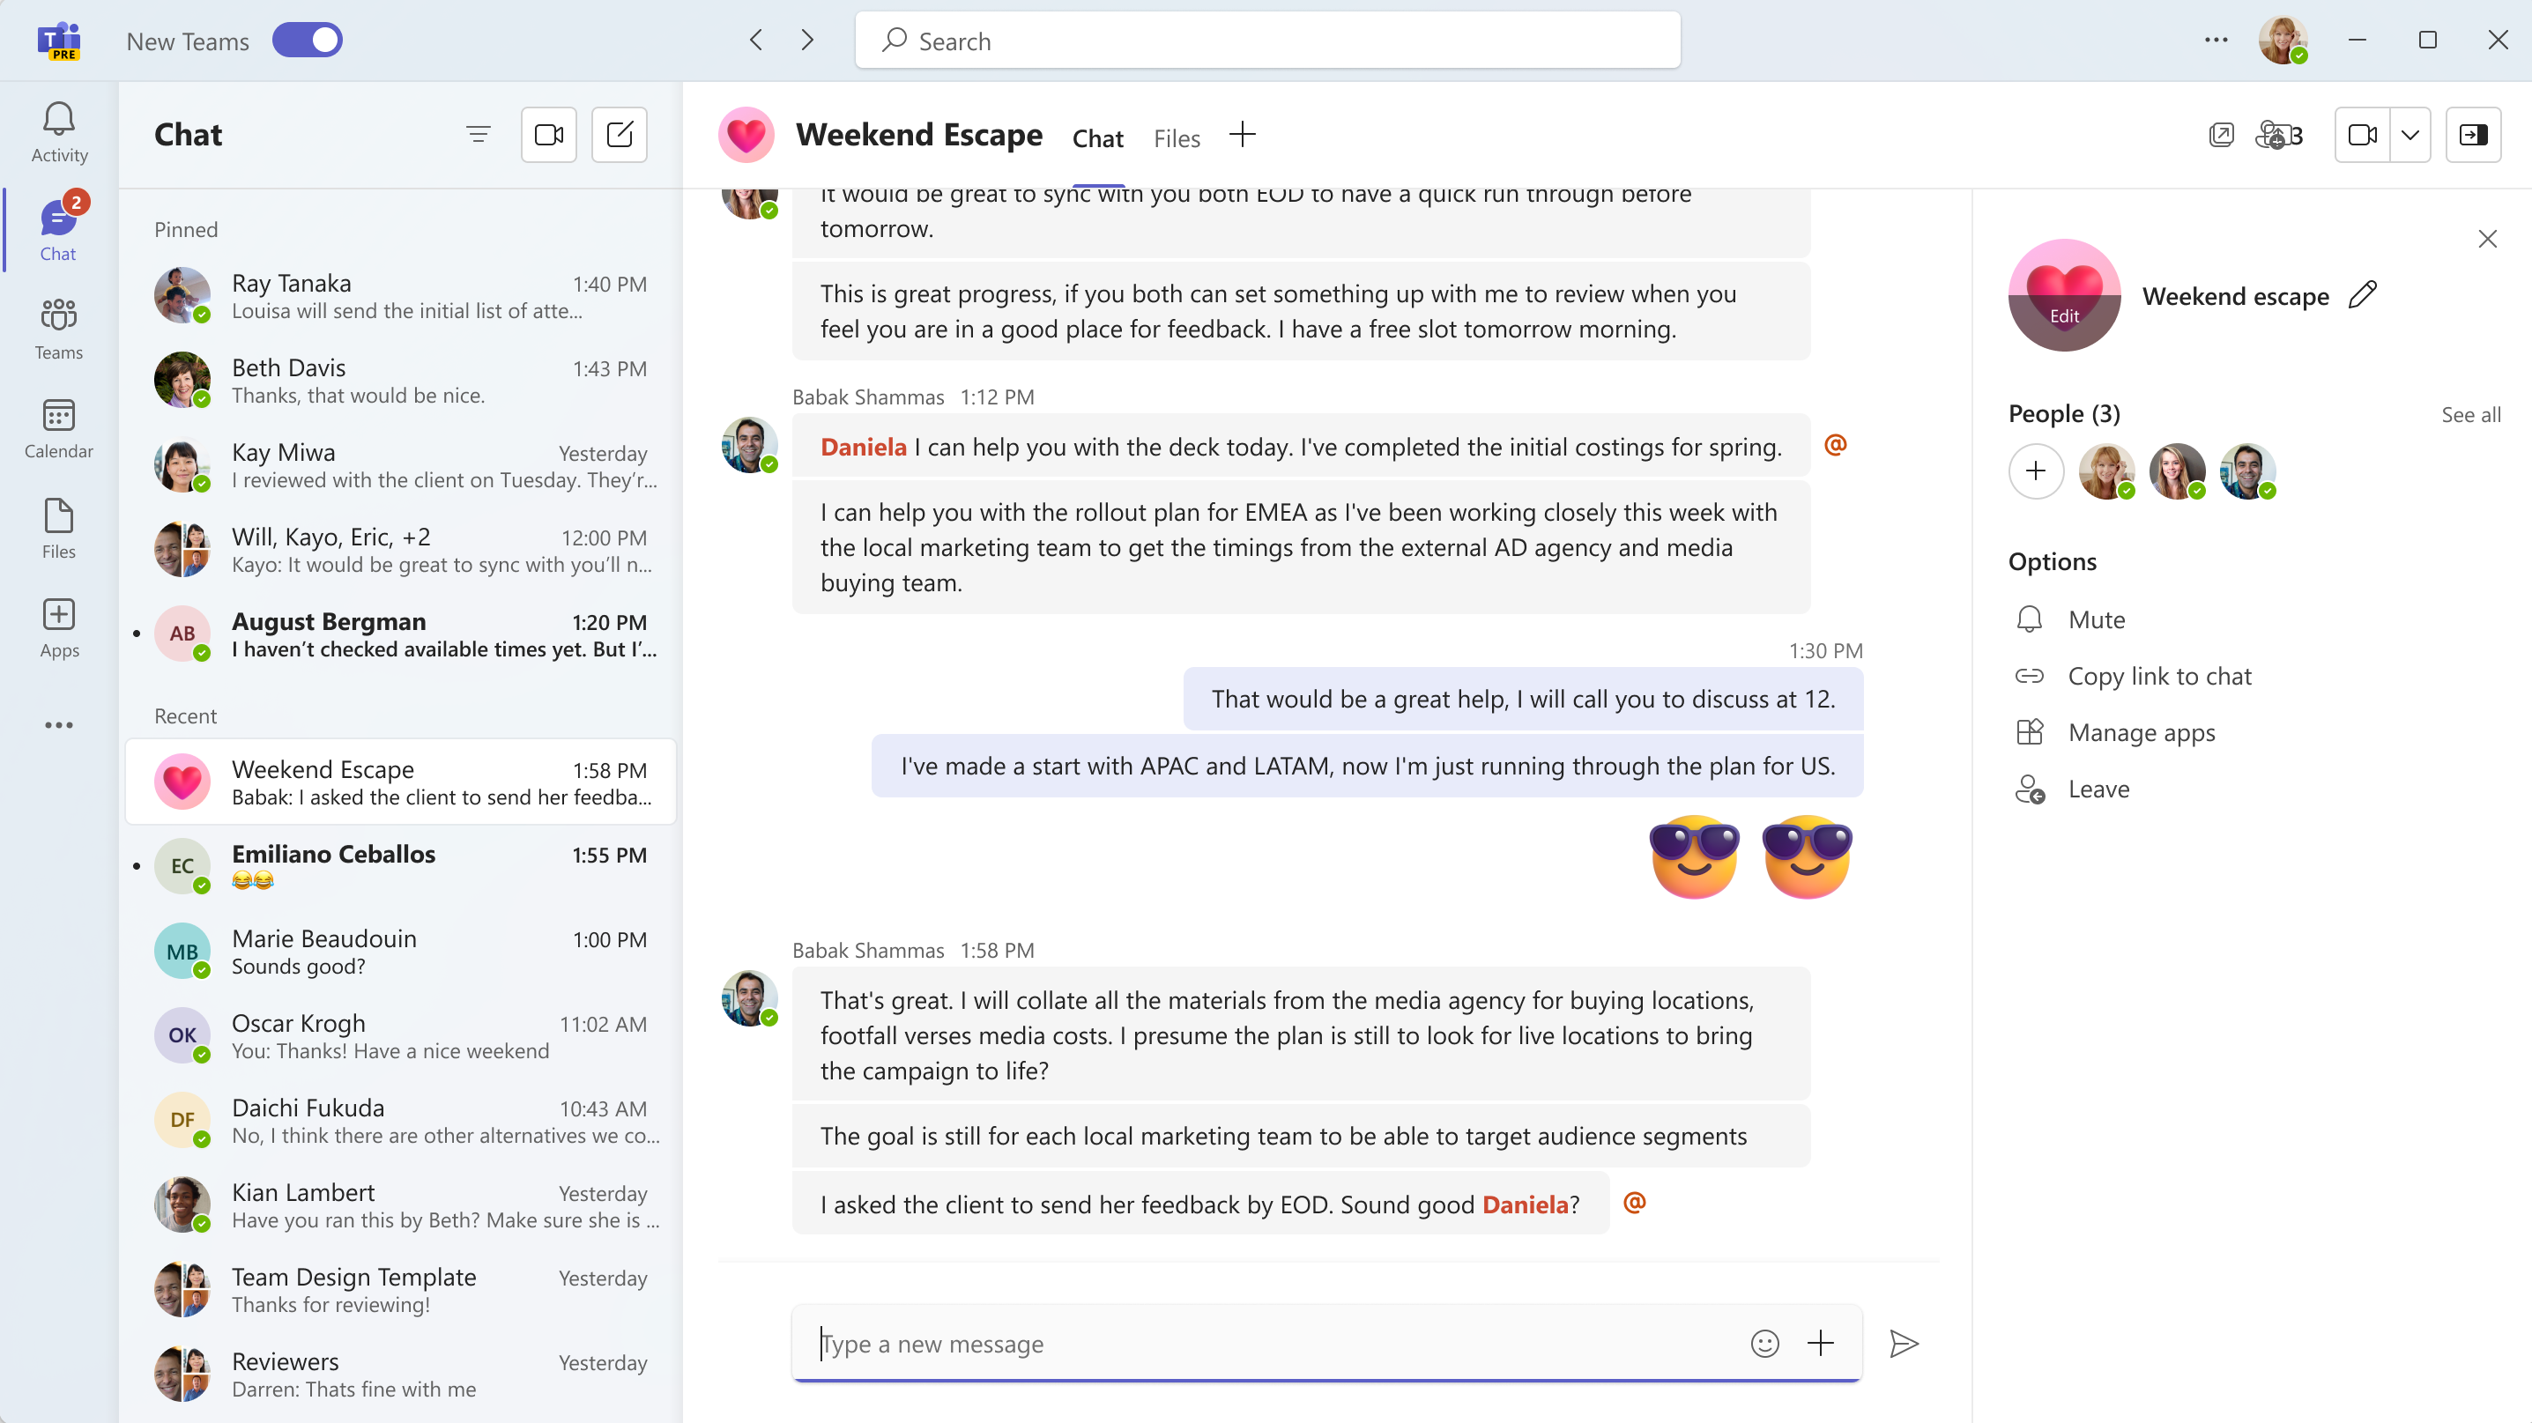



Try the new Teams toggle for Help Desk
It's simpler than ever for your users to switch to the new Teams
1
2
1
Flip the toggle in the upper-left corner to switch from classic to new Teams. Users can always switch back using the same toggle in the new experience.
2
Personalize each account and organization with a color theme to quickly recognize which workspace you’re in.
3
3
4
Note: Help has moved! Select Settings and more next to your profile picture at the top right of the new Teams, then select Help > Suggest a feature or Report a problem to send feedback about how to improve the new Teams experience.
4
Pro Tip: You can always keep classic Teams running in a web browser window for quick
and easy access if you find yourself switching frequently.
11 | Introducing the new Microsoft Teams

Slide 12
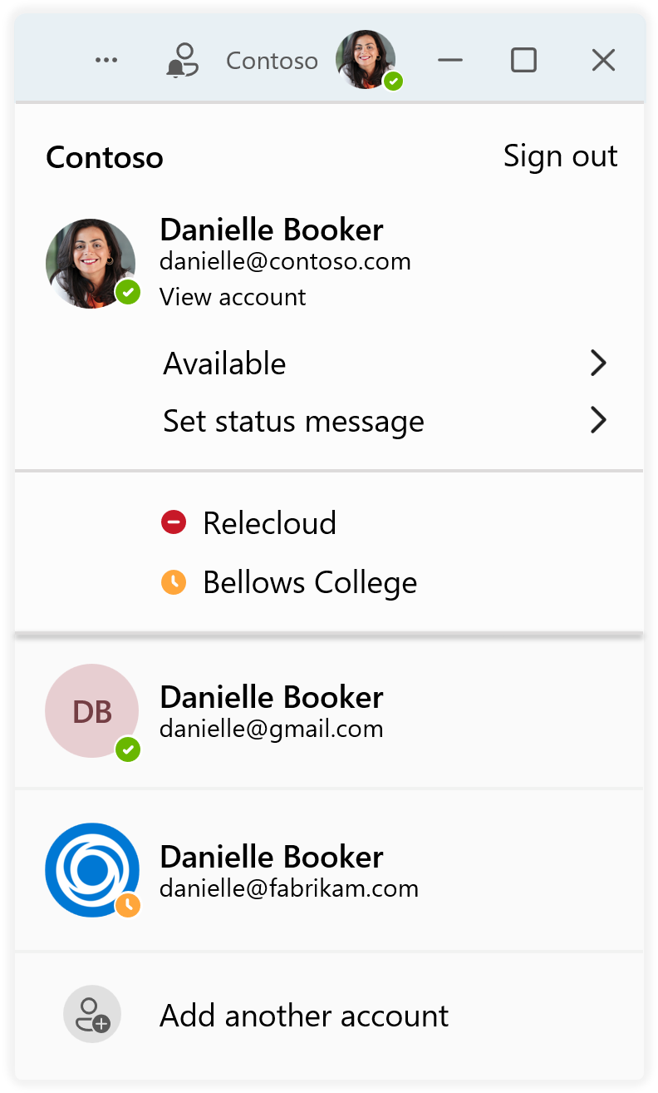
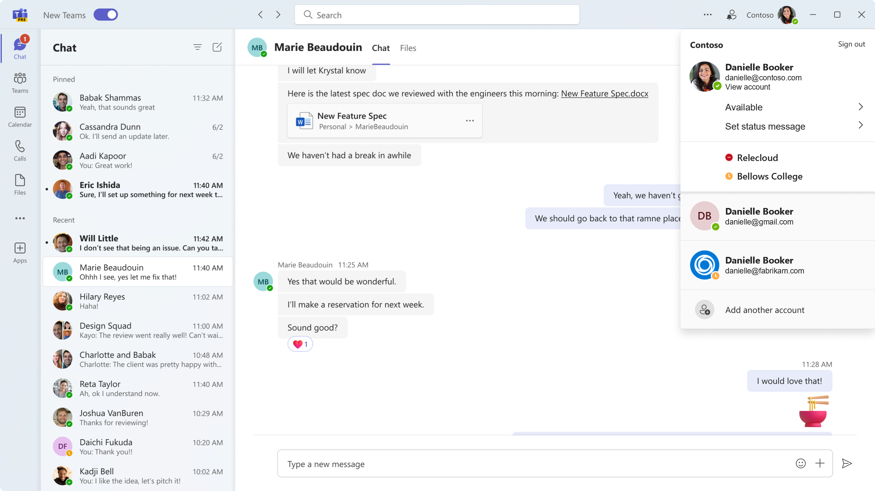
Multi-Tenant Multi-Account for Help Desk
Seamlessly use work or school accounts simultaneously within the same browser
Select your profile picture in the upper right to
switch or add accounts and organizations
Set your status for each account and organization individually
Easily switch between multiple accounts and organizations without dropping from a call or meeting
To add another account, select your profile picture
at the top right of the new Teams, then select Add another account
12 | Introducing the new Microsoft Teams

Slide 13
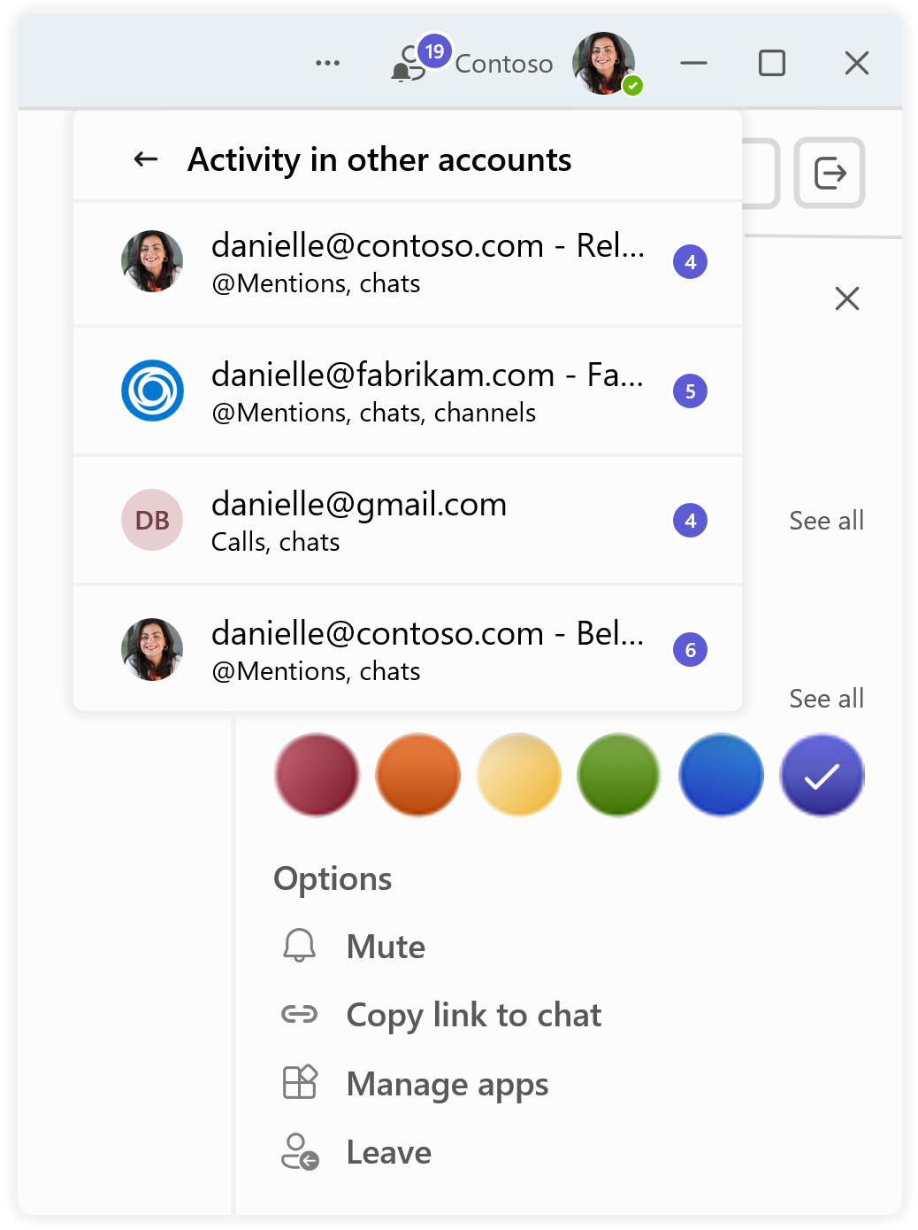
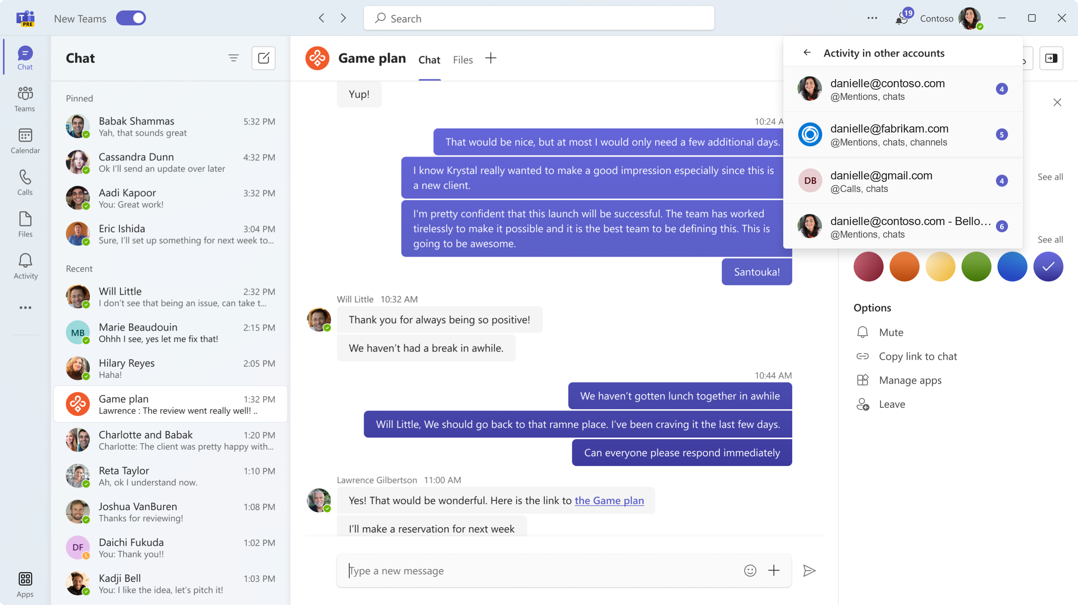
Multi-Tenant Multi-Account for Help Desk (continued)
Enable users to easily communicate and collaborate with who they need to
See activity and receive real-time notifications from all your accounts and associated organizations in
one place
Personalize each account and organization with a color theme to quickly recognize which workspace you’re in
Easily mute notifications, copy links from a chat, manage your apps, or leave an account or organization from a simple options list
13 | Introducing the new Microsoft Teams

Slide 14

Resources to get started
Microsoft Adoption: Get started and find resources for your org
Microsoft Teams Tech Community Blog: Read the new Teams GA announcement
Enable new Teams in your organization: Upgrade to new Teams now!
Microsoft Teams technical documentation: find a more detailed release schedule, step-by-step instructions on how to enable the new Teams, and a known issues list
End-user guidance: Learn on how to start using new Teams today
Microsoft Tech Community Forum: Share your experience with other customers in the community
Microsoft Teams Feedback portal: Send suggestions to improve the new Teams experience
14 | Introducing the new Microsoft Teams

Slide 15

©2023 Microsoft Corporation. All rights reserved. This document is provided “as-is”. Information and views expressed in this document, including URL and other Internet website references, may change without notice. You bear the risk of using it. This document does not provide you with any legal rights to any intellectual property in any Microsoft product. You may copy and use this document for your internal reference purposes.

